Slide 1
Discipleship: An Introduction to Systematic Theology and Apologetics
The Doctrines of Redemption: The Reformers
The Heights Church January 21, 2018

Slide 2
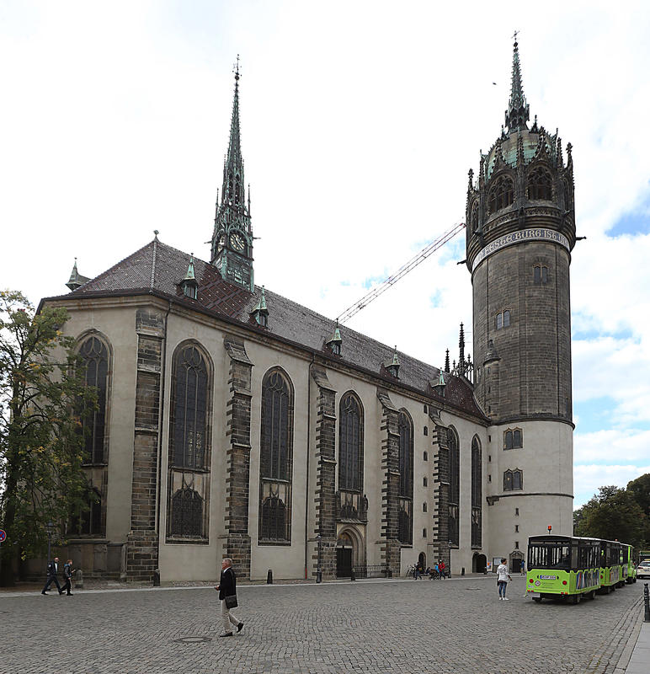
The Reformation – Castle Church in Wittenberg

Slide 3
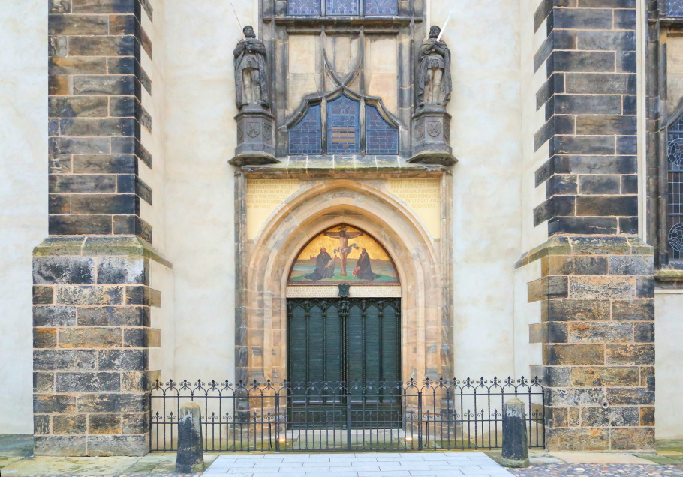
The Reformation – The Door to Castle Church in Wittenberg

Slide 4
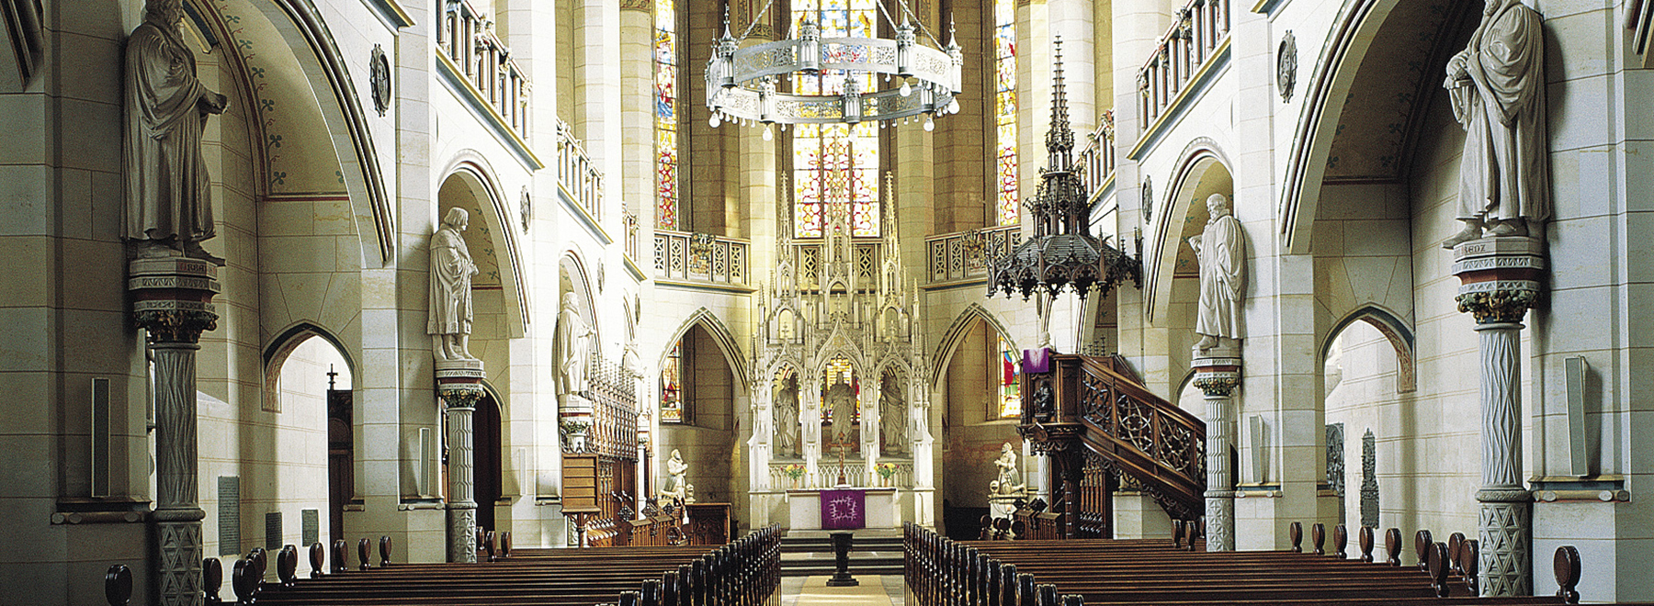
The Reformation – Castle Church in Wittenberg
The name of the castle is probably derived from German: Warte, a watchtower and German word for a fortress (Burg).
It houses the tombs, intact to this day, of the two reformers Martin Luther and Philipp Melanchthon, and of the Electors Frederick the Wise and John the Steadfast.

Slide 5
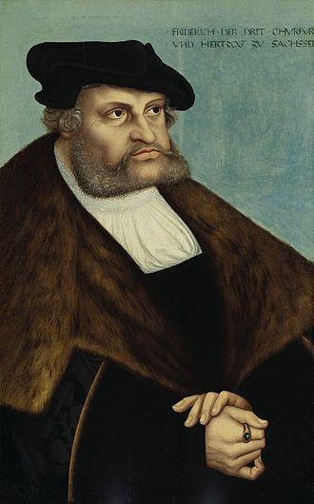
The Reformation – Fredrick the Wise January 17, 1463 – May 5, 1525
Succeeded his father as Elector of Saxony in 1486.
Reigned August 26, 1486 – May 5, 1525
In those days the Elector of Saxony was second only to the Holy Roman Emperor.
Frederick was among the princes who pressed the need of reform upon Holy Roman Emperor Maximilian I.
In 1502, he founded the University of Wittenberg.
Frederick was Pope Leo X's candidate for Holy Roman Emperor in 1519.
Frederick collected many relics in his castle church; his inventory of 1518 listed 17,443 items, including a thumb from St. Anne, a twig from Moses' burning bush, hay of the holy manger, and milk from the Virgin Mary.
By 1520, the collection exceeded 19,000 pieces.

Slide 6
The Reformation – Fredrick the Wise 1463 - 1525
Money was paid in order to venerate these relics and thus escape years in purgatory. A diligent and pious person who rendered appropriate devotion to each of these relics could merit 1,902,202 years worth of penance (an earthly equivalent of time otherwise spent in Purgatory, removed by indulgences)

Slide 7
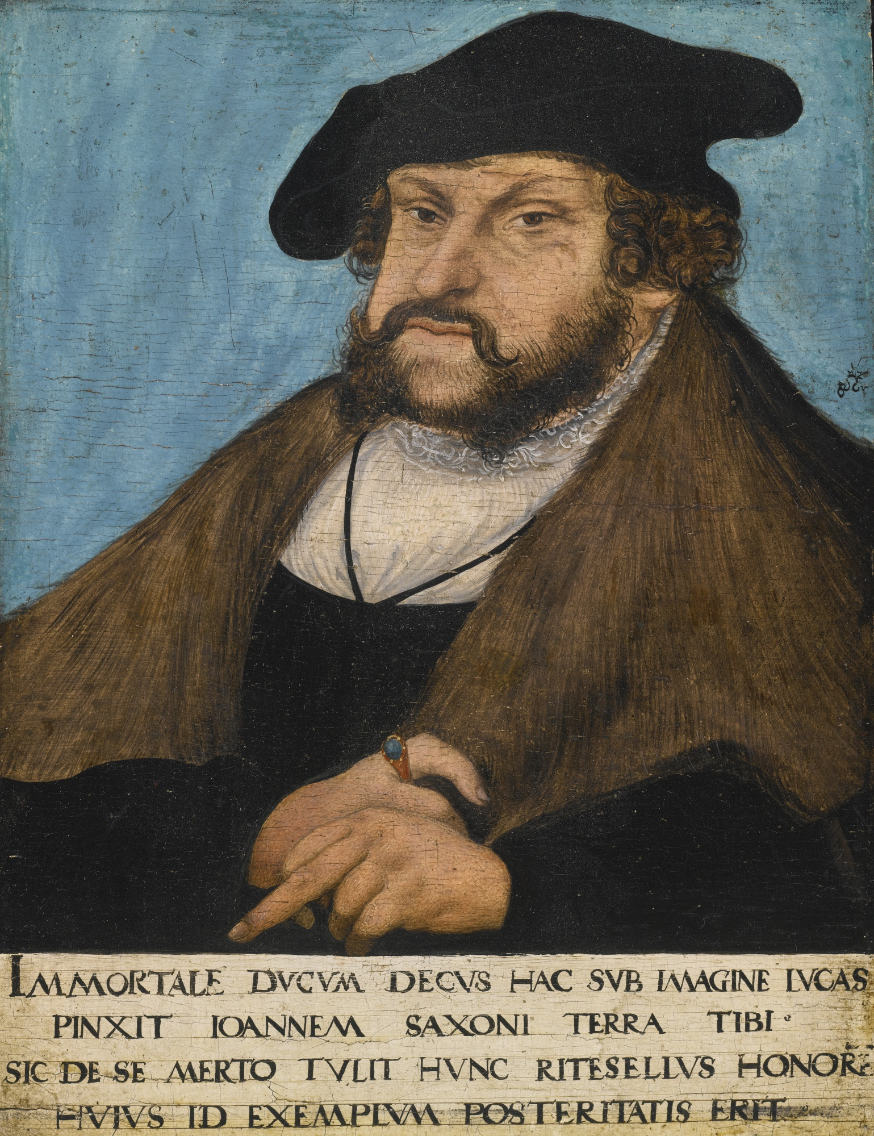
The Reformation – John the Steadfast June 30, 1468 – August 16, 1532
Succeeded Fredrick the Wise, his older brother, as Elector of Saxony.
Reigned May 5, 1525 - August 16, 1532
Continued to protect Luther and mandated that Luther’s teachings were continued in Saxony.

Slide 8
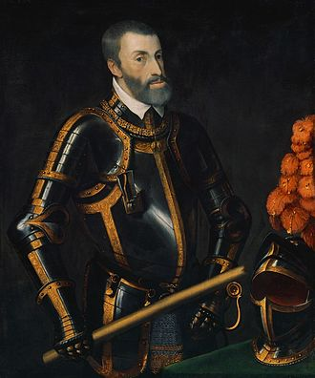
The Reformation – Holy Roman Emperor Charles V (Feb. 24 1500 – Sept. 21 1558)
1519 succeeded his paternal grandfather, Maximilian as HRE, defeating Frederick III, Francis I of France, and Henry VIII of England.
Catherine of Aragon was his Aunt
Crowned 28 June 1519.
His reign was dominated by conflicts with France, which was encircled by HRE.
Initially he dismissed Luther’s 95 theses as "an argument between monks“
In 1521 Charles called Martin Luther to the Diet of Worms, promising him safe conduct.
Later in 1521 he outlawed Luther and his followers but war with France broke out shortly thereafter. Charles delegated increasing responsibility for Germany to his brother Ferdinand while he concentrated on wars with Islam and France.

Slide 9
The Reformation (95 Theses)
Out of love for the truth and from desire to elucidate it, the Reverend Father Martin Luther, Master of Arts and Sacred Theology, and ordinary lecturer therein at Wittenberg, intends to defend the following statements and to dispute on them in that place. Therefore he asks that those who cannot be present and dispute with him orally shall do so in their absence by letter. In the name of our Lord Jesus Christ, Amen.
1. Our Lord and Master Jesus Christ, in saying, "Repent ye, etc.," intended that the whole life of his believers on earth should be a constant penance.
2. And the word "penance" neither can, nor may, be understood as referring to the Sacrament of Penance, that is, to confession and atonement as exercised under the priest's ministry.
21. Therefore, those preachers of indulgences err who say that, by the Pope's indulgence, a man may be exempt from all punishments, and be saved.
22. Yea, the Pope remits the souls in Purgatory no penalty which they, according to the canons, would have had to pay in this life.
27. They preach vanity who say that the soul flies out of Purgatory as soon as the money thrown into the chest rattles.

Slide 10
The Reformation (95 Theses)
28. What is sure, is, that as soon as the penny rattles in the chest, gain and avarice are on the way of increase; but the intercession of the church depends only on the will of God Himself.
32. On the way to eternal damnation are they and their teachers, who believe that they are sure of their salvation through indulgences.
35. He preaches like a heathen who teaches that those who will deliver souls out of Purgatory or buy indulgences do not need repentance and contrition.
36. Every Christian who feels sincere repentance and woe on account of his sins, has perfect remission of pain and guilt even without letters of indulgence.
41. The Pope's indulgence ought to be proclaimed with all precaution, lest the people should mistakenly believe it of more value than all other works of charity.
45. Christians should be taught, he who sees his neighbor in distress, and, nevertheless, buys indulgence, is not partaking in the Pope's pardons, but in the anger of God.
46. Christians should be taught, unless they are rich enough, it is their duty to keep what is necessary for the use of their households, and by no means to throw it away on indulgences.

Slide 11
The Reformation (95 Theses)
47. Christians should be taught, the buying of indulgences is optional and not commanded.
54. Wrong is done to the word of God if one in the same sermon spends as much or more time on indulgences as on the word of the Gospel.
76. We assert on the contrary that the Popish pardon cannot take away the least of daily sins, as regards the guilt of it.
86. Again:- Why does not the Pope build St. Peter's Minster with his own money - since his riches are now more ample than those of Crassus, - rather than with the money of poor Christians?
89. If the Pope seeks by his pardon the salvation of souls, rather than money, why does he annul letters of indulgence granted long ago, and declare them out of force, though they are still in force?
92. Away, then, with all those prophets who say to the people of Christ, ``Peace, peace,'' and there is no peace! (Jer 6:14)
94. Christians should be exhorted to endeavor to follow Christ their Head through Cross, Death, and Hell,
95. And thus hope with confidence to enter Heaven through many miseries, rather than in false security.

Slide 12
The Reformation (History of Indulgences)
As the doctrine of purgatory evolved, the practice and teaching on indulgences shifted to the shortening of punishments in purgatory for oneself or somebody else in exchange for a good deed done in this life.
On December 4, 1563, the Council of Trent took up the matter in a late, short and hastily devised decree that reaffirmed the medieval teaching but condemned abuses. The Council of Trent addressed the question of indulgences directly, declaring them "most salutary for the Christian people", decreeing that "all evil gains for the obtaining of them be wholly abolished", and instructing bishops to be on the watch for any abuses concerning them. In 1567, Pope Pius V canceled all grants of indulgences involving any fees or other financial transactions.
On Jan. 1, 1967, Paul VI issued the apostolic constitution Indulgentiarum Doctrina, a long instruction that was a modest reworking of the medieval teaching on indulgences.

Slide 13
The Reformation (History of Indulgences – Vatican II)
Chapter 2, "The Treasury of the Church “ . . . the ‘treasury of the Church’ is the infinite value, which can never be exhausted, which Christ’s merits have before God . . . This treasury includes as well the prayers and good works of the Blessed Virgin Mary. They are truly immense, unfathomable and even pristine in their value before God. In the treasury, too, are the prayers and good works of all the saints, all those who have followed in the footsteps of Christ the Lord and by his grace have made their lives holy and carried out the mission the Father entrusted to them. In this way they attained their own salvation and at the same time cooperated in saving their brothers in the unity of the Mystical Body.”
Chapter 4, “How Indulgences Developed from the Canonical Penances” ….he (Jesus) has entrusted it (Indulgences)to blessed Peter, the key-bearer of heaven, and to his successors who are Christ’s vicars on earth, so that they may distribute it to the faithful for their salvation. They may apply it with mercy for reasonable causes to all who have repented for and have confessed their sins. At times they may remit completely, and at other times only partially, the temporal punishment due to sin in a general as well as in special ways (insofar as they judge it to be fitting in the sight of the Lord). The merits of the Blessed Mother of God and of all the elect . . . are known to add further to this treasure.”

Slide 14
The Reformation (History of Indulgences – Vatican II)
“How Indulgences Have Been Abused in the Past” “Unfortunately, the practice of indulgences has on occasions been improperly applied. …The Church deplored and corrected these improper uses. It ‘teaches and commands that the usage of indulgences—a usage most beneficial to Christians and approved by the authority of the Sacred Council—should be kept in the Church; and it condemns with anathema those who say that indulgences are useless or that the Church does not have the power to grant them.’” [Vatican II quotes in the final sentence of this section from the Council of Trent, Decree on Indulgences]
July 13, 2016 the Vatican announced "indulgences" will be granted to followers of Pope Francis' tweets. Indulgences are also granted to those who carry out certain tasks – such as climbing the Sacred Steps, in Rome (reportedly brought from Pontius Pilate's house after Jesus scaled them before his crucifixion), earning believers seven years off purgatory. Attendance at events or following the "rites and pious exercises" of the event on television, radio or through social media (like Catholic World Youth Day, in Rio de Janeiro, July 22 - 29, 2017) can also count.

