Slide 1
Discipleship: An Introduction to Systematic Theology and Apologetics
The Doctrines of Redemption: The Reformers
The Heights Church January 28, 2018

Slide 2
The Reformation – Mortal Sin (last week clarification)
A Mortal sin is a sinful act, which can lead to damnation if a person does not repent of the sin before death.
A Mortal sin meets all three of the following criteria:
Its subject matter must be grave.
It must be committed with full knowledge (and awareness) of the sinful action and the gravity of the offense.
It must be committed with deliberate and complete consent.
According to the catechism: Grave matter is specified by the Ten Commandments, corresponding to the answer of Jesus to the rich young man: "Do not kill, Do not commit adultery, Do not steal, Do not bear false witness, Do not defraud, Honor your father and your mother." (Matthew 19:16-30; Mark 10:17-31; Luke 18:18-30)
The gravity of sins is more or less great: murder is graver than theft. One must also take into account who is wronged: violence against parents is in itself graver than violence against a stranger.

Slide 3
The Reformation (16th century)
April, 26, 1518 the Heidelberg Disputation.
1519 Luther returns to the Psalms
Early in 1519 Luther is converted.
June – July 1519, The Leipzig Debate between Karlstadt, Luther, and Johann Eck.
Charles V is crowned HRE June 28, 1519.
June 15, 1520, the Pope warned Luther with a papal bull that he risked excommunication unless he recanted 41 sentences drawn from his writings, including the Ninety-five Theses, within 60 days.
August 1520 Luther writes To the Christian Nobility of the German Nation – calls on the nobility to make the reforms Rome refuses to make.
September 1520 Johann Eck posts the Bull throughout Germany.
October 1520 Luther writes On the Babylonian Captivity of the Church – Attacks the Catholic interpretation of the Sacraments.
October 1520 Luther receives the Papal Bull declaring it condemns Christ and a Bull of the Antichrist.

Slide 4
The Reformation (16th century)
November 1520 Luther writes On the Freedom of a Christian – lays out justification by faith alone. Also concludes living outside the commands of Christ is bondage not freedom. It was published with an open letter to Pope Leo X.
December 10, 1520 (60 days after receiving the Bull) Luther lead several hundred professors and students outside the Wittenberg city wall and burned the Bull under a large oak tree along with several books of canon law and some of Eck’s writings.
April 16 – 18, 1521 Luther before the Diet of Worms
May 26, 1521 Emperor Charles V, issues the Edict of Worms: “For this reason we forbid anyone from this time forward to dare, either by words or by deeds, to receive, defend, sustain, or favor the said Martin Luther.”
May 1521 to March 1522, Martin Luther stayed at Wartburg castle under the name of Junker Jörg (the Knight George) translating the Greek NT into German.
February 1522 The Second Imperial Diet of Nuremberg declared the Edict of Worms to be unenforceable.
March 1522 Luther returned to Wittenberg.

Slide 5
The Reformation – The Heidelberg Disputation
Brother Martin Luther, Master of Sacred Theology, will preside, and Brother Leonhard Beyer, Master of Arts and Philosophy, will defend the following theses before the Augustinians of this renowned city of Heidelberg in the customary place, on April 26th 1518.
Distrusting completely our own wisdom, according to that counsel of the Holy Spirit, Do not rely on your own insight Prov. 3:5(Trust in the LORD with all your heart, and do not lean on your own understanding.), we humbly present to the judgment of all those who wish to be here these theological paradoxes, so that it may become clear whether they have been deduced well or poorly from St. Paul, the especially chosen vessel and instrument of Christ, and also from St. Augustine, his most trustworthy interpreter.
Luther’s Distillation of the 95 Theses into 28 theses made them more significant than the 95 theses. Theses 25 and 28 in particular summarize the essence of the document.
Theses 25. He is not righteous who does much, but he who, without work, believes much in Christ.
Theses 28. The love of God does not find, but creates, that which is pleasing to it. The love of man comes into being through that which is pleasing to it.

Slide 6
The Reformation – Luther’s Conversion (Luther's Works, Volume 34, P336-337).
Meanwhile, I had already during that year returned to interpret the Psalter anew. I had confidence in the fact that I was more skillful, after I had lectured in the university on St. Paul's epistles to the Romans, to the Galatians, and the one to the Hebrews. I had indeed been captivated with an extraordinary ardor for understanding Paul in the Epistle to the Romans. But up till then it was not the cold blood about the heart, but a single word in Chapter 1, "In it the righteousness of God is revealed," that had stood in my way. For I hated that word "righteousness of God," which, according to the use and custom of all the teachers, I had been taught to understand philosophically regarding the formal or active righteousness, as they call it, with which God is righteous and punishes the unrighteous sinner.
Though I lived as a monk without reproach, I felt that I was a sinner before God with an extremely disturbed conscience. I could not believe that he was placated by my satisfaction. I did not love, yes, I hated the righteous God who punishes sinners, and secretly, if not blasphemously, certainly murmuring greatly, I was angry with God, and said, "As if, indeed, it is not enough, that miserable sinners, eternally lost through original sin, are crushed by every kind of calamity by the law of the decalogue, without having God add pain to pain by the gospel and

Slide 7
The Reformation – Luther’s Conversion (Luther's Works, Volume 34, P336-337).
also by the gospel threatening us with his righteousness and wrath!” Thus I raged with a fierce and troubled conscience. Nevertheless, I beat importunately upon Paul at that place, most ardently desiring to know what St. Paul wanted.
16 For I am not ashamed of the gospel, for it is the power of God for salvation to everyone who believes, to the Jew first and also to the Greek.
17 For in it the righteousness of God is revealed from faith for faith, as it is written, "The righteous shall live by faith.“ (Romans 1:16-17)
At last, by the mercy of God, meditating day and night, I gave heed to the context of the words, namely, "In it the righteousness of God is revealed, as it is written, 'He who through faith is righteous shall live.'" There I began to understand that the righteousness of God is that by which the righteous lives by a gift of God, namely by faith. And this is the meaning: the righteousness of God is revealed by the gospel, namely, the passive righteousness with which merciful God justifies us by faith, as it is written, "He who through faith is righteous shall live." Here I felt that I was altogether born again and had entered paradise itself through open gates. There a totally other face of the entire Scripture showed itself to me. Thereupon I ran through the Scripture from memory. I also found in other terms an analogy, as, the work of God, that is what God does

Slide 8
The Reformation – Luther’s Conversion (Luther's Works, Volume 34, P336-337).
the glory of God in us, the power of God, with which he makes us wise, the strength of God, the salvation of God, and I extolled my sweetest word with a love as great as the hatred with which I had before hated the word "righteousness of God." Thus that place in Paul was for me truly the gate to paradise. Later I read Augustine's The Spirit and the Letter, where contrary to hope I found that he, too, interpreted God's righteousness in a similar way, as the righteousness with which God clothes us when he justifies us. Although this was heretofore said imperfectly and he did not explain all things concerning imputation clearly, it nevertheless was pleasing that God's righteousness with which we are justified was taught. Armed more fully with these thoughts, I began a second time to interpret the Psalter. And the work would have grown into a large commentary, if I had not again been compelled to leave the work begun, because Emperor Charles V in the following year convened the diet at Worms.

Slide 9
The Reformation – Luther’s Conversion
Following his conversion Luther wrote about himself – “ I am rough, boisterous, stormy, and altogether warlike. I am born to fight against innumerable monsters and devils. I must remove stumps and stones, cut away thistles and thorns, and clear wild forests.”
Later when asked how the reformation succeeded he said, “I simply taught, preached and wrote God’s Word; otherwise I did nothing. And while I slept, or drank Wittenberg beer with my friends Phillip and Amsdorf, the Word so greatly weakened the papacy that no prince or emperor ever inflicted such losses upon it. I did nothing; the Word did everything.”

Slide 10
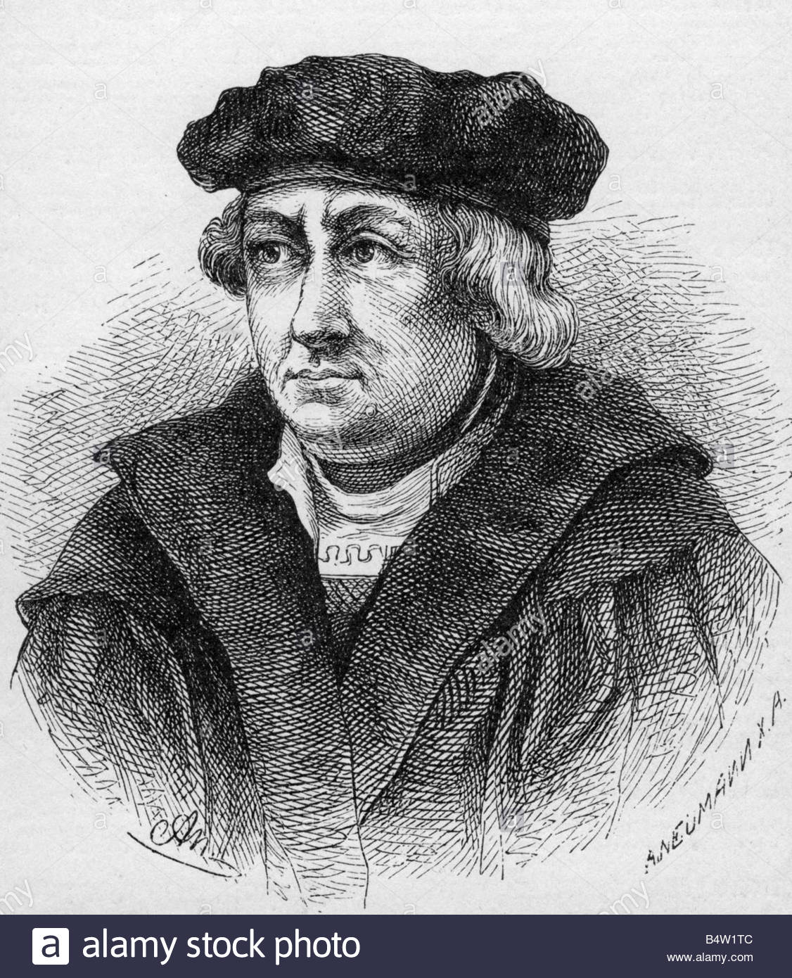
The Reformation – The Leipzig Debate June-July 1519
Johann Eck – German Scholastic Theologian and staunch defender of the Papacy

Slide 11
The Reformation – The Leipzig Debate June-July 1519
Prior to the actual debate Luther and Eck had exchanged correspondence over 12 topics. What had started out as an argument about indulgences quickly descended into name-calling chaos, because Andreas Karlstadt, one of Luther’s colleagues at Wittenberg, thought he had to defend Luther’s reputation by making the quiet dispute between Luther and Eck public. There were months of pre-debate theses, and counter theses, as well as arguments over venues, judges, and opponents.
Just before the debate Luther added a 13th theses. (Eck later admitted that he was willing to concede to Luther on 12 of the 13 theses.)
13. The very callous decrees of the Roman pontiffs which have appeared in the last four hundred years prove that the Roman church is superior to all others. Against them stand the history of eleven hundred years, the test of divine Scripture, and the decree of the Council of Nicaea, the most sacred of all councils.” (excerpt from Luther’s book On the Papacy at Rome published in the Spring of 1519)
Karlstadt presumed he would debate Eck himself, but as the debate progressed on grace and free will it became clear that Luther needed to debate Eck rather than Karlstadt.

Slide 12
The Reformation – The Leipzig Debate June-July 1519
Luther and Eck then shifted the discussion toward authority in the church on July 4, 1519.
Luther eventually responded to the claim that he was supporting a condemned position by defending many of Hus’s positions as essentially orthodox. When Eck questioned his defense of a noted heretic, Luther countered that the Council of Constance, which sentenced Hus to death, could have been in error. This led him to state that councils could and had erred, as had popes and canon law. What remained infallible for Luther was Scripture and thus it was finally authoritative for the church.
For the first time, Luther had articulated clearly his position that popes, councils, and theologians were all subject to error, leaving Scripture as the supreme authority in all theological matters.
According to the rules of the debate the theological faculties of the University of Erfurt and the University of Paris were to declare the winner. The theological faculty of Erfurt recused itself and the faculty in Paris delivered a negative verdict on Luther's writings in 1521, but made no direct reference to the debate in Leipzig itself.

Slide 13
The Reformation – The Diet of Worms January 28 – May 26, 1521
On April, 16 Luther arrived in Worms. Luther was told to appear the following day before the Diet at 4 p.m. Dr. Schurff, Wittenberg professor in Canon Law, was to act as Luther’s lawyer before the Diet.
On April 17 Luther was told that he should speak only in answer to direct questions from the presiding officer, Johann Eck. Eck asked if a collection of books was Luther’s and if he was ready to revoke their heresies. Dr. Schurff said, "Please have the titles read." There were 25 of them, probably including The 95 Theses, Resolutions Concerning the 95 Theses, On the Papacy at Rome, Address to the Christian Nobility, The Babylonian Captivity of the Church, and On the Freedom of a Christian. Luther requested more time for a proper answer, so he was given until the next day at 4 p.m.
On April 18, Luther came before the Diet stating that he'd prayed for long hours and consulted with friends and mediators. When the counselor put the same questions to him, Luther first apologized that he lacked the etiquette of the court. Then he answered, "They are all mine, but as for the second question, they are not all of one sort.” Luther went on to place the writings into three categories:

Slide 14
The Reformation – The Diet of Worms January 28 – May 26, 1521
Works which were well received by even his enemies: those he would not reject.
Books which attacked the abuses, lies and desolation of the Christian world and the papacy: those, Luther believed, could not safely be rejected without encouraging abuses to continue. To retract them would be to open the door to further oppression. “If I now recant these, then, I would be doing nothing but strengthening tyranny".
Attacks on individuals: he apologized for the harsh tone of these writings but did not reject the substance of what he taught in them; if he could be shown from the Scriptures that he was in error, he would reject them.
Luther concluded by saying: Unless I am convinced by the testimony of the Scriptures or by clear reason (for I do not trust either in the pope or in councils alone, since it is well known that they have often erred and contradicted themselves), I am bound by the Scriptures I have quoted and my conscience is captive to the Word of God. I cannot and will not recant anything, since it is neither safe nor right to go against conscience. May God help me. Amen.

Slide 15
The Reformation – The Diet of Worms January 28 – May 26, 1521
According to tradition, Luther is said to have declared, "Here I stand, I can do no other," before concluding with "God help me. Amen.“. However, there is no indication in the transcripts of the Diet or in eyewitness accounts that he ever said this.
Eck then spoke to Luther saying: Martin, there is no one of the heresies which have torn the bosom of the church, which has not derived its origin from the various interpretation of the Scripture. The Bible itself is the arsenal whence each innovator has drawn his deceptive arguments. It was with biblical texts that Pelagius and Arius maintained their doctrines. … When the fathers of the council of Constance condemned this proposition of John Huss—The church of Jesus Christ is only the community of the elect, they condemned an error; for the church, like a good mother, embraces within her arms all who bear the name of Christian, all who are called to enjoy the celestial beatitude.
Private conferences were held to determine Luther's fate, but he was not arrested at Worms. Luther had been given a letter of safe conduct to and from the hearing so he departed for Wittenberg.
However, fearing for Luther's safety, Frederick The Wise sent men to a fake highway attack and abduct Luther, hiding him away at Wartburg Castle.

Slide 16
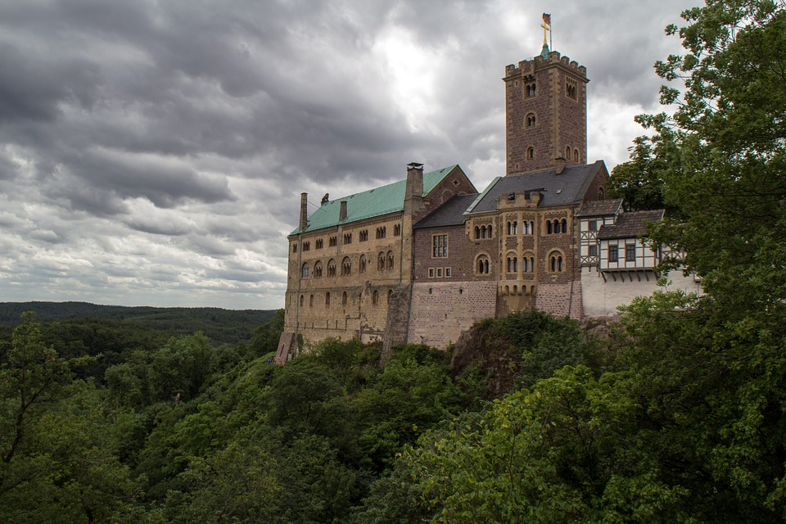
The Reformation – Wartburg Castle
The name of the castle is derived from German: Warte, a watchtower and German word for a fortress (Burg).

Slide 17
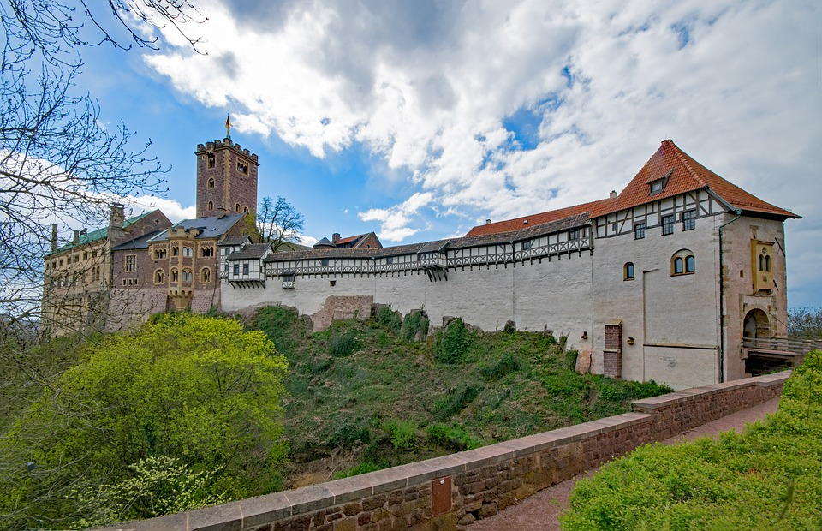
The Reformation – Wartburg Castle

Slide 18
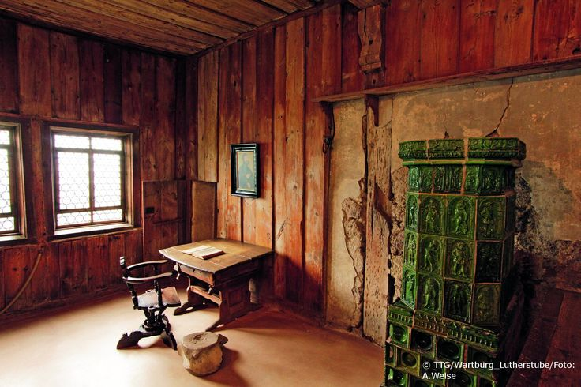
The Reformation – Luther’s Room in Wartburg Castle

