Slide 1
Discipleship: An Introduction to Systematic Theology and Apologetics
The Doctrines of Redemption: The Reformers
The Heights Church February 4, 2018

Slide 2
The Reformation (16th century)
September 21, 1522 The German NT is published. 5000 copies sold in two months to every class of people.
1522 Luther preached 117 Sunday sermons in Wittenberg and 134 in 1523. Between 1510 and 1546 Luther preached over 7000 sermons! About 2300 survive to this day.
March 6, 1523 Diet or Nuremburg orders Luther to stop publishing his sermons and outlawed preaching anything but Roman Catholic Doctrine until a new diet can be called.
In 1524 the Diet of Nuremburg renewed its ban on Luther. By now he was so popular it would have been impossible to stop him.
September 1, 1524 Erasmus publishes On Freedom of the Will – attacking Luther’s teaching on the radical corruption of the unregenerate human heart and will.
1525 Luther writes On Bondage of the Will.
1524-1525 Peasants War – many peasants mistook their spiritual liberty in Christ as a license to revolt. April 19 1525 Luther releases Admonition to Peace Calling on peasants to submit to civil authorities.
June 13, 1525 Luther is married and moves into the Black Cloister, the Augustinian Monastery in Wittenberg. John the Steadfast transferred it to Luther in 1532.

Slide 3
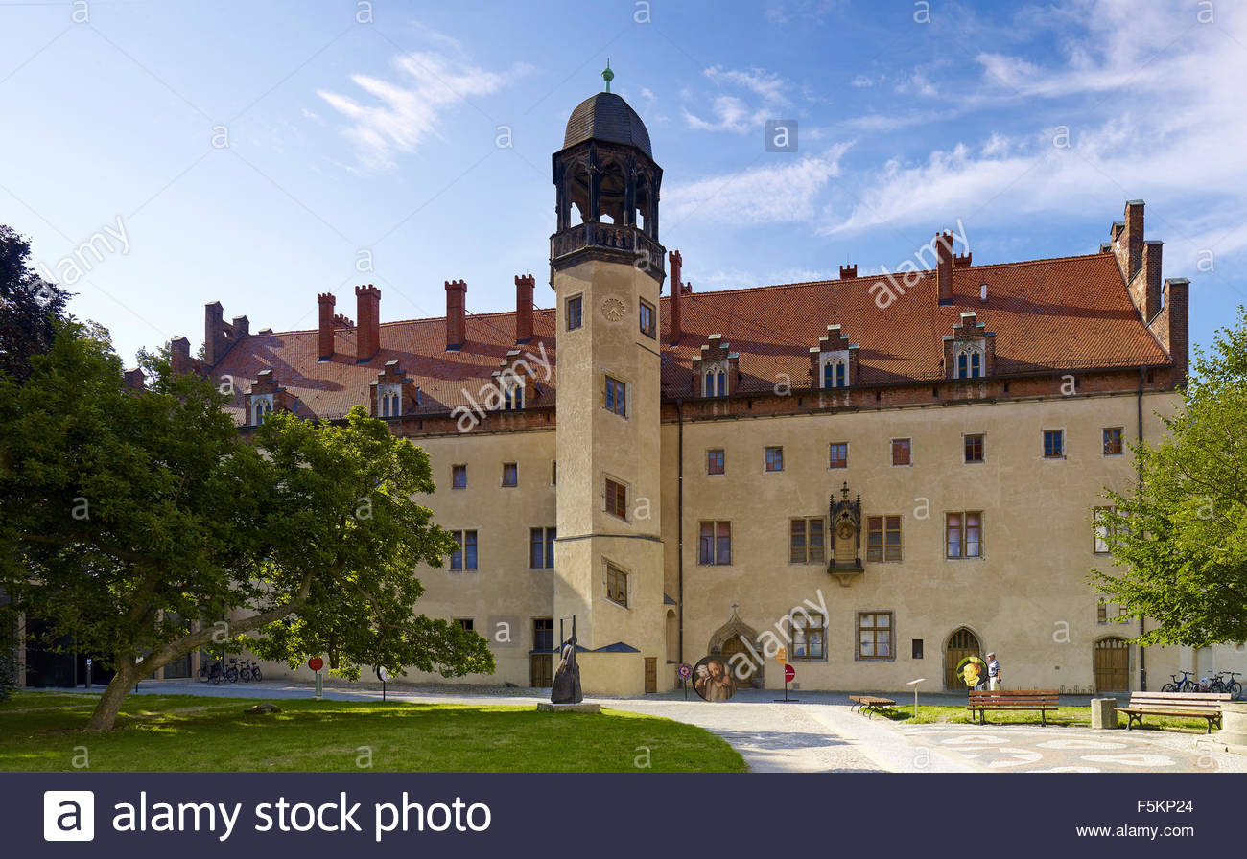
The Reformation – Luther’s home in Wittenberg

Slide 4
The Reformation (16th century)
May 15, 1525 Battle of Frankenhausen 5000 peasant slain and 300 beheaded. Luther responds with Against the Murderous, Thieving Hordes of Peasants. He calls them “mad dogs doing the devil’s work and petitions the magistrates to kill them.
The defeat of Hungary at the Battle of Mohács in 1526 "sent a wave of terror over Europe." The Muslim advance in Central Europe was halted at the Siege of Vienna in 1529 marking the greatest advance of Islam into central Europe. Bitter military tension and reciprocal attacks ensued, culminating in the Battle of Vienna September 11-12, 1683.
April 22, 1527 Luther became so dizzy in the pulpit that he had to stop preaching. This was followed by severe heart problems, digestive problems and fainting spells as well as bouts of discouragement and depression.
On July 6, 1527 he suffered a severe attack and believed he would die. In desperate prayer he surrendered to the will of God and prepared to die. After many days he regained his strength.

Slide 5
The Reformation (16th century)
In August 1527 The Black Plague spread through Wittenberg. Katie was pregnant and one year old Hans was severely ill. Luther believed it his duty to stay with the people and used his house as a hospital. For eleven days he did not eat and was severely depressed. In a letter to Melanchthon he wrote:
“I spent more than a week in death and in hell. My entire body was in pain, and I still tremble. Completely abandoned by Christ, I labored under the vacillations and storms of desperation and blasphemy against God. But through the prayers of the saints, God began to have mercy on me and pulled my soul from the inferno below.”
When the Black Plague ended in Wittenberg in 1528 the Reformation gained momentum and spread throughout the major cities of Germany.
Some time between 1527 and 1529 Luther wrote a Mighty Fortress Is Our God. When Luther would get depressed he would meet with Melanchthon and say, “come Philip let us sing the 46th Psalm.” The original words were: A sure stronghold our God is He, a timely shield and weapon: Our help He’ll be and set us free from every ill that can happen.

Slide 6
The Reformation (16th century)
In March 1529 Luther published his Small Catechism followed in May by the Large Catechism.
On October 1, 1529 Luther met with Zwingli at the Marburg Colloquy; They agreed on everything but the presence of Christ in the Lord’ Supper. Luther withheld his hand of fellowship from Zwingli and the Reformation was divided.
1530 Luther spent five months at Coburg Castle during the Diet of Augsburg. While he was there his father died. Luther took his Psalter went to his room and wept for two days.

Slide 7
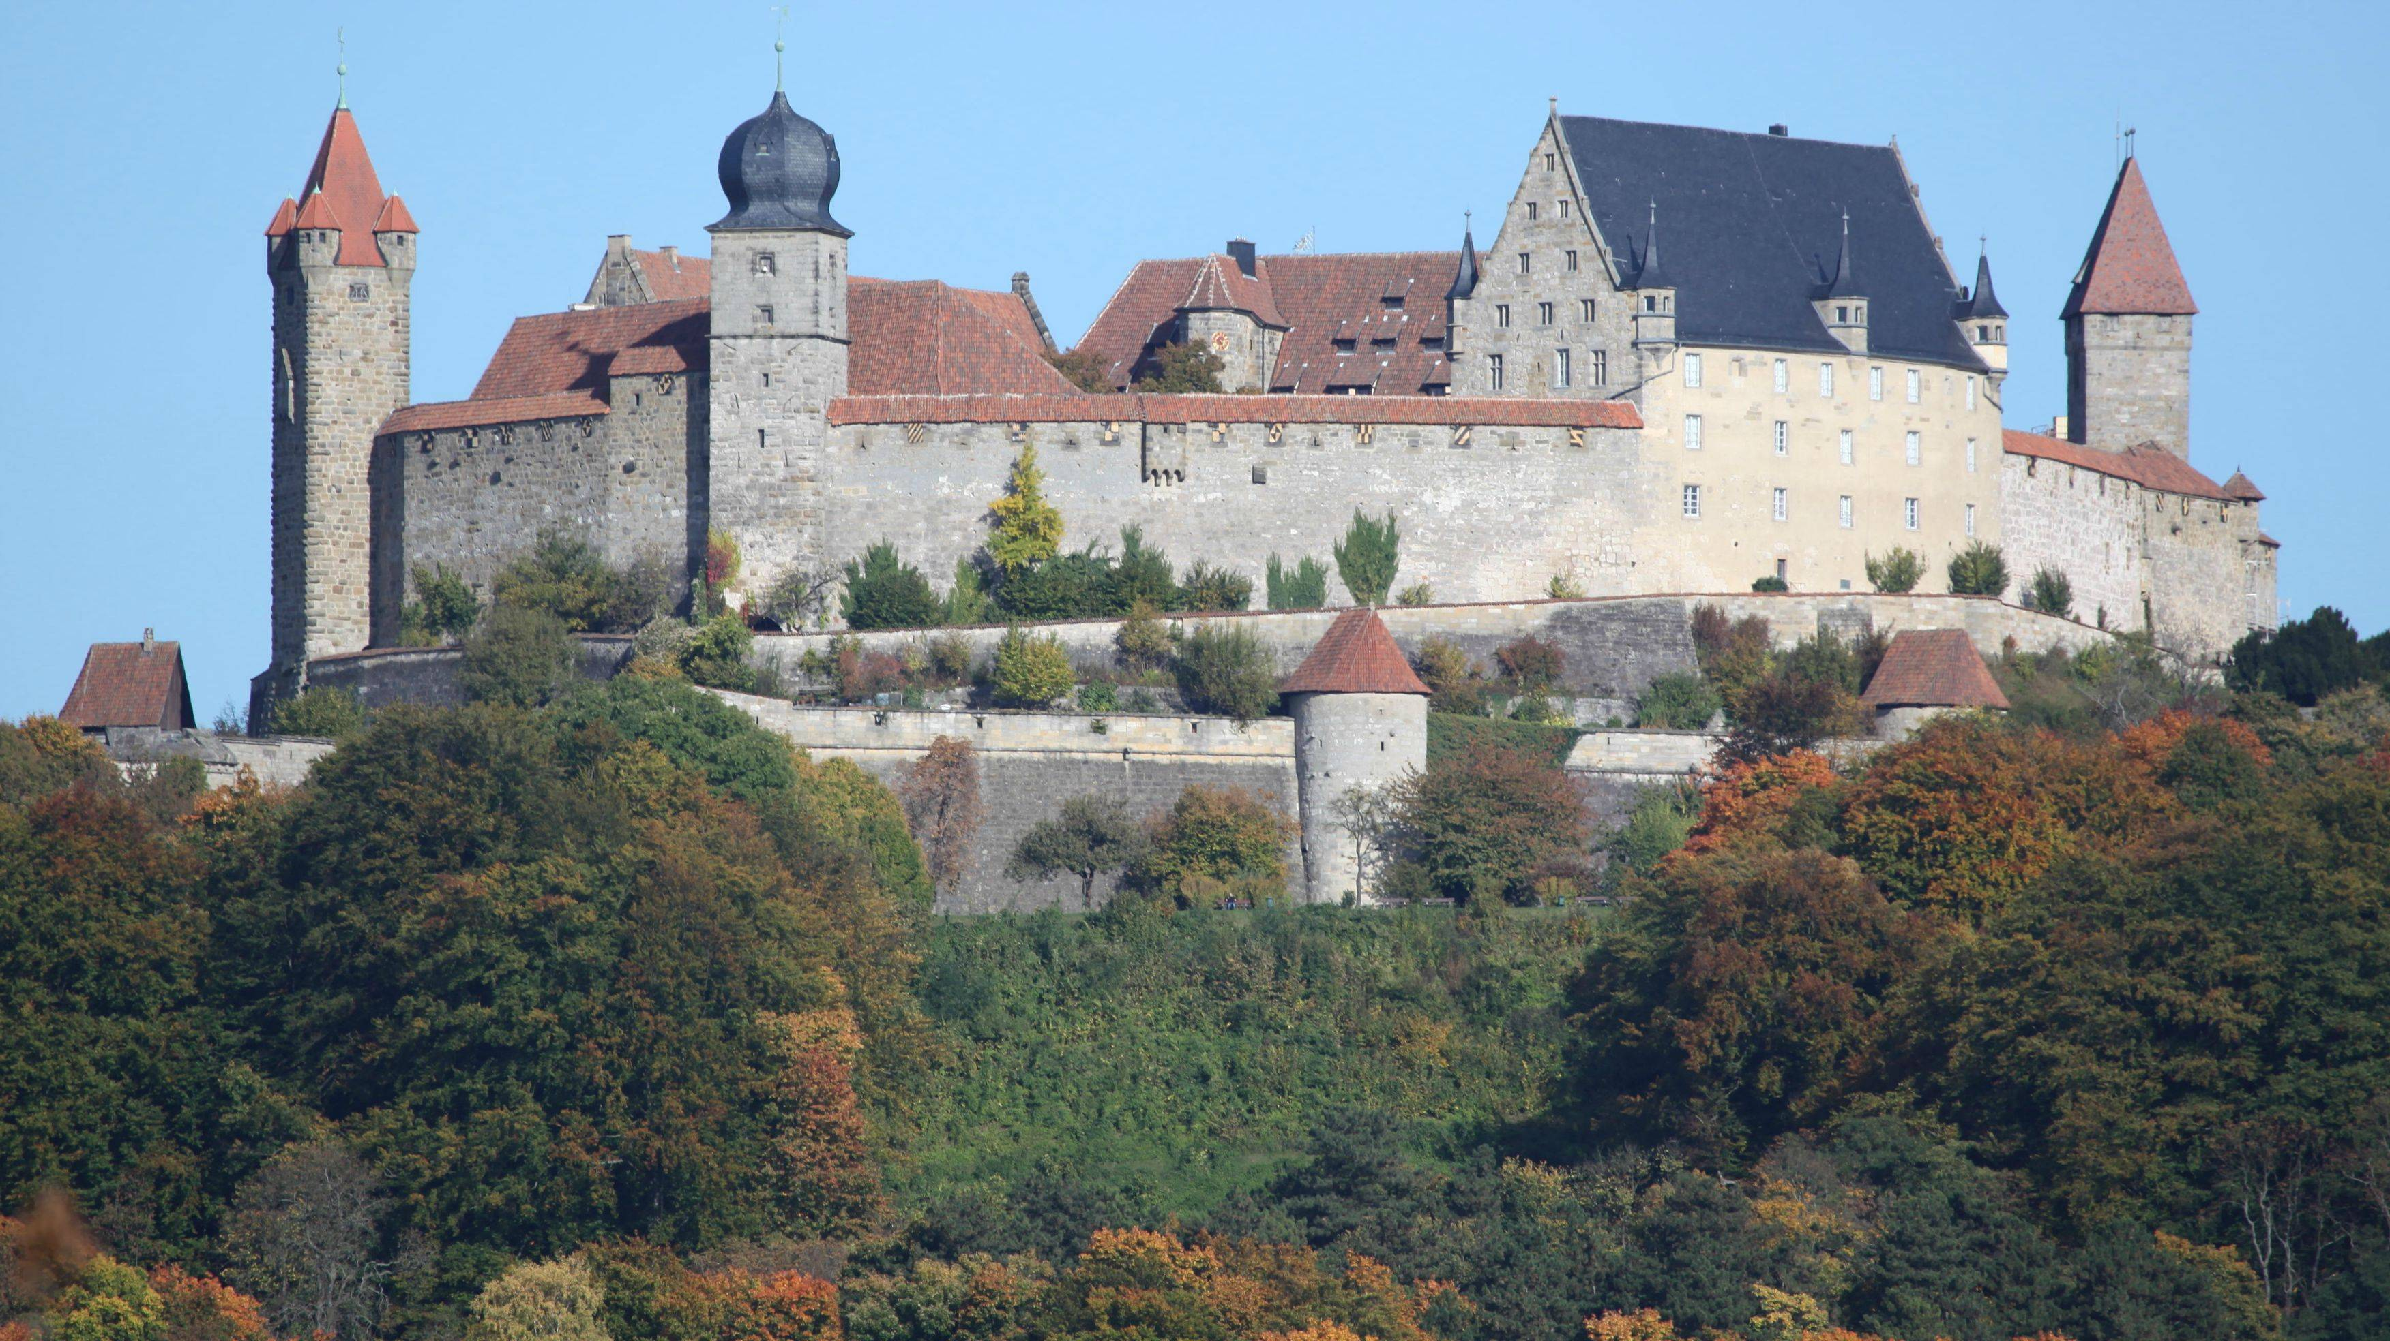
The Reformation – Coburg Castle

Slide 8
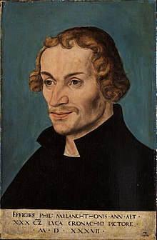
The Reformation – Philip Melanchthon February 16, 1497 – April 19, 1560.
Philip Melanchthon was a German Lutheran reformer, collaborator with Martin Luther, the first systematic theologian of the Protestant Reformation, and intellectual leader of the Lutheran Reformation. After Luther himself, he is the primary founder of Lutheranism.
He accepted a call to the University of Wittenberg from Martin Luther, and became professor of Greek there at the age of 21. In 1519 he attended the Leipzig disputation as a spectator. Later that year he was granted the degree of bachelor of theology, and transferred to the theological faculty at the University of Wittenberg.
He married Katharina (the daughter of Wittenberg's mayor).
In 1530 Melanchthon was the principal author of the Augsburg Confession one on the most important documents of the Reformation. Melanchthon then settled into the comparative quiet of his academic and literary labors.

Slide 9
The Reformation – Philip Melanchthon February 16, 1497 – April 19, 1560.
Melanchthon's importance for the Reformation lay essentially in the fact that he systematized Luther's ideas, defended them in public, and made them the basis of a religious education.
As a reformer, Melanchthon was characterized by moderation, conscientiousness, caution, and love of peace; but these qualities were sometimes said to only be lack of decision, consistence, and courage.

Slide 10
The Reformation – The Augsburg Confession June 25, 1530
The Holy Roman Emperor Charles V had called on the Princes and Free Territories in Germany to explain their religious convictions in an attempt to restore religious and political unity in the Holy Roman Empire and rally support against the Turkish invasion.
The Augsburg Confession consists of 28 articles presented by Lutheran princes and representatives of "free cities" at the Diet of Augsburg that described what Lutherans believed, taught and confessed in positive (theses) and negative (antitheses) statements. The theses are 21 Chief Articles of Faith describing the normative principles of Christian faith held by the Lutherans; the antitheses are seven statements describing what they viewed as abuses of the Christian faith present in the Roman church.
Following the public reading of the Augsburg Confession in June 1530, the response by Charles V and the Vatican representatives at the Diet of Augsburg was delayed due to debate between the court of Charles V and the Vatican representatives. The official response was finally completed, though the document was so poorly prepared that the document was never published for widespread distribution, nor presented to the Lutherans at the Diet.

Slide 11
The Reformation – The Augsburg Confession June 25, 1530
In September, Charles V declared the response to be sufficient and gave the Lutheran princes until 15 April 1531 to respond to the demands of the Confutation. In response, Philip Melanchthon wrote a lengthy and sustained argument both supporting the Augsburg Confession and refuting the arguments made in the Confutation. This document became known as the Apology of the Augsburg Confession. It was widely distributed and read throughout Germany.
The Lutheran princes at the diet formed a military alliance in the event Charles V attacked them known as the Schmalkaldic League. The political tensions between the Schmalkaldic League and Charles V and the Vatican led to the Schmalkaldic War in 1546–1547, which was won convincingly by Charles V. The war did not resolve the religious and political situation. In 1555 the Lutheran princes and Charles V agreed to the Peace of Augsburg, which granted Lutheranism legal status within the Holy Roman Empire.
Theological disputes as Lutheranism expanded into other territories led to the compilation of a definitive set of Lutheran Confessions in the Book of Concord (Concordia) in 1580. The Book of Concord includes the Augsburg Confession and the Apology of the Augsburg Confession as the foundational confessions of the Lutheran faith.

Slide 12
The Reformation (Luther’s later years 1531-1546)
Martin Luther said of his dog Topel, “The dog is the most faithful of animals and would be much esteemed were it not so common. Our Lord God has made His greatest gifts the commonest.” “Oh, if I could only pray the way this dog watches the meat! All his thoughts are concentrated on the piece of meat. Otherwise he has no thought, wish, or hope.”
1531 Luther’s mother died.
1531 Luther described his workload: “Four times a week I preach in public, twice a week I lecture, I hear cases for pastoral counseling, write letters and am working on a book.
1534 the first edition of the Wittenberg Bible was released including the OT and NT in every day German.
1535 Luther becomes Dean of Wittenberg University

