Slide 1
Discipleship: An Introduction to Systematic Theology and Apologetics
The Doctrines of Redemption: The Reformers
The Heights Church March 11, 2018

Slide 2
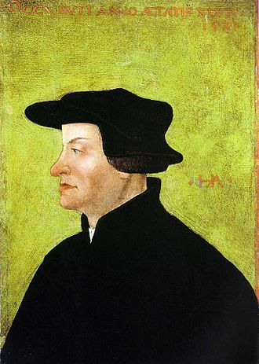
The Reformation – Huldrych Zwingli January 1, 1484 - 1531
In 1506 he received a Master of Arts degree from the University of Basel in 1506 and was ordained a priest in Glarus, where he served for ten years.
At the University of Basel, Zwingli was trained in the theological system of Thomas Aquinas, in which “he remained even as a reformer—a Thomist for whom revelation and reason can never contradict.”
Zwingli was heavily influenced by the Dutch humanist Erasmus, who had a rationalistic approach to Scripture.
January 1, 1518, after a two year sabbatical, he took up parish duties in Zurich, where he became the chief reformer of the Swiss reformation and began preaching from the Greek NT.
The most significant point of contention between the Reformers was over the Eucharist. On October 1 – 4, 1529, Luther and Zwingli met at the Marburg Colloquy.

Slide 3
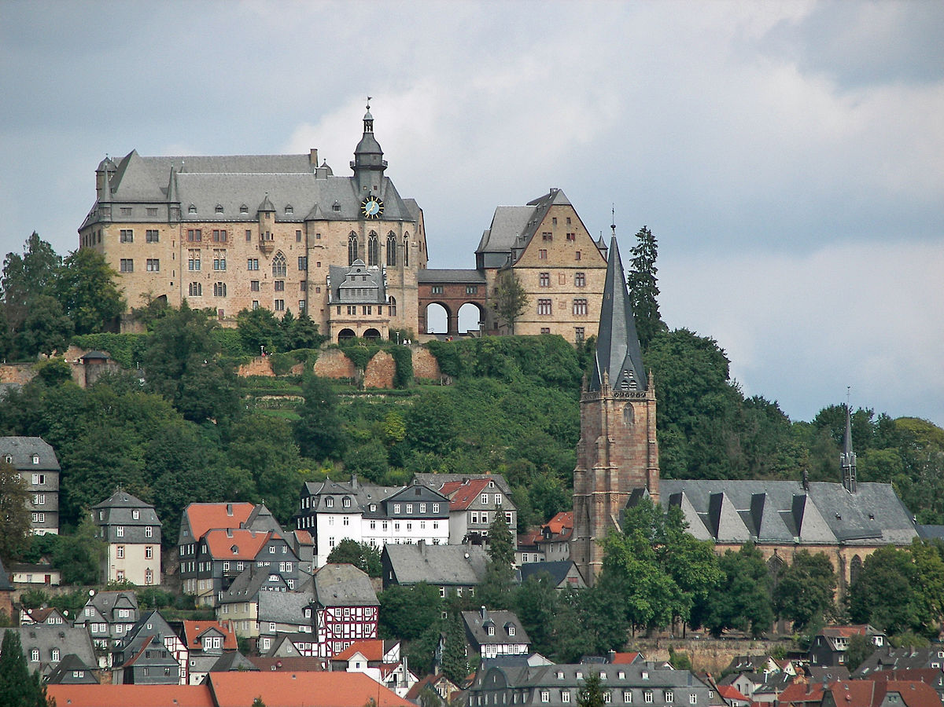
The Reformation – Marburg Castle and the Marburg Colloquy October 1-4, 1529

Slide 4
The Reformation – Huldrych Zwingli January 1, 1484 - October 11, 1531
Luther believed that God’s revelation in Holy Scripture often contradicts human reason. Though Luther was well trained in philosophy, he took his stand squarely in the words of Holy Scripture. This meant that when God’s revelation seemed to contradict human philosophical/theological understanding, Luther didn’t try to reconcile the two.
Luther and Zwingli agreed on three key points:
Christ’s presence in the Eucharist.
The Eucharist is a sign that strengthens faith in the hearts of believers.
Transubstantiation as well as the Roman Catholic understanding of the mass as a sacrifice is a false doctrine.
Zwingli argued that the bread and wine only “signify” or “represent” Jesus’ body and blood, which, he argued, were not capable of being at the right hand of God the Father in heaven and in bread and wine on the altar at the same time. Because for Zwingli revelation cannot contradict reason he made his argument for the bread “representing” Jesus’ body from passages of Scripture other than those directly connected to Jesus’ institution of the Lord’s Supper, especially John 6.

Slide 5
The Reformation – Huldrych Zwingli January 1, 1484 - October 11, 1531
Jesus said to them, "I am the bread of life; whoever comes to me shall not hunger, and whoever believes in me shall never thirst. But I said to you that you have seen me and yet do not believe. All that the Father gives me will come to me, and whoever comes to me I will never cast out. For I have come down from heaven, not to do my own will but the will of him who sent me. And this is the will of him who sent me, that I should lose nothing of all that he has given me, but raise it up on the last day. For this is the will of my Father, that everyone who looks on the Son and believes in him should have eternal life, and I will raise him up on the last day.“ (John 6:35- 40)…..Truly, truly, I say to you, whoever believes has eternal life. (John 6:47)…….I am the living bread that came down from heaven. If anyone eats of this bread, he will live forever. And the bread that I will give for the life of the world is my flesh.“ (John 6:51)……So Jesus said to them, "Truly, truly, I say to you, unless you eat the flesh of the Son of Man and drink his blood, you have no life in you. Whoever feeds on my flesh and drinks my blood has eternal life, and I will raise him up on the last day. For my flesh is true food, and my blood is true drink. Whoever feeds on my flesh and drinks my blood abides in me, and I in him. As the living Father sent me, and I live because of the Father, so whoever feeds on me, he also will live because of me. (John 6:53 – 57)

Slide 6
The Reformation – Huldrych Zwingli January 1, 1484 - October 11, 1531
Luther argued that the words of Jesus, with which He instituted the Lord’s Supper, clearly teach that the bread, received into the mouth of those who eat it, is—not signifies, nor represents—the body of Christ.
Though rejecting the idea that the bread and wine were actually transformed, Luther believed that Christ’s body and blood were sacramentally united to the bread and wine, so that when one ate the bread, one was eating Christ’s body. Thus Luther went farther than the Roman Catholic Church, by stating that if a person’s teeth crush the bread, then the same thing happens to Christ’s body also, since Christ’s body is united to the bread.
“I do not ask how Christ can be God and man and how His natures could be united. For God is able to act far beyond our imagination. To the Word of God one must yield. It is up to you to prove that the body of Christ is not there when Christ Himself says, ‘This is my body.’ I do not want to hear what reason says. I completely reject carnal or geometrical arguments…”

Slide 7
The Reformation – Huldrych Zwingli January 1, 1484 – October 11, 1531
When it became apparent that agreement could not be reached, Phillip I of Hesse asked Luther to draft a statement regarding the discussion. Luther wrote:
Regarding the Last Supper of our dear Lord Jesus Christ, we believe and hold that one should practice the use of both species as Christ himself did, and that the sacrament at the altar is a sacrament of the true body and blood of Jesus Christ and the spiritual enjoyment of this very body and blood is proper and necessary for every Christian. Furthermore, that the practice of the sacrament is given and ordered by God the Almighty like the Word, so that our weak conscience might be moved to faith through the Holy Spirit. And although we have not been able to agree at this time, whether the true body and blood of Christ are corporally present in the bread and wine [of communion], each party should display towards the other Christian love, as far as each respective conscience allows, and both should persistently ask God the Almighty for guidance so that through his Spirit he might bring us to a proper understanding.
In Tabletalk, Luther is recorded saying: "They say that Zwingli recently died thus; if his error had prevailed, we would have perished, and our church with us. It was a judgment of God. That was always a proud people. The others, the papists, will probably also be dealt with by our Lord God."

