Slide 1
First Christian Church of Europe
Acts 16

Slide 2
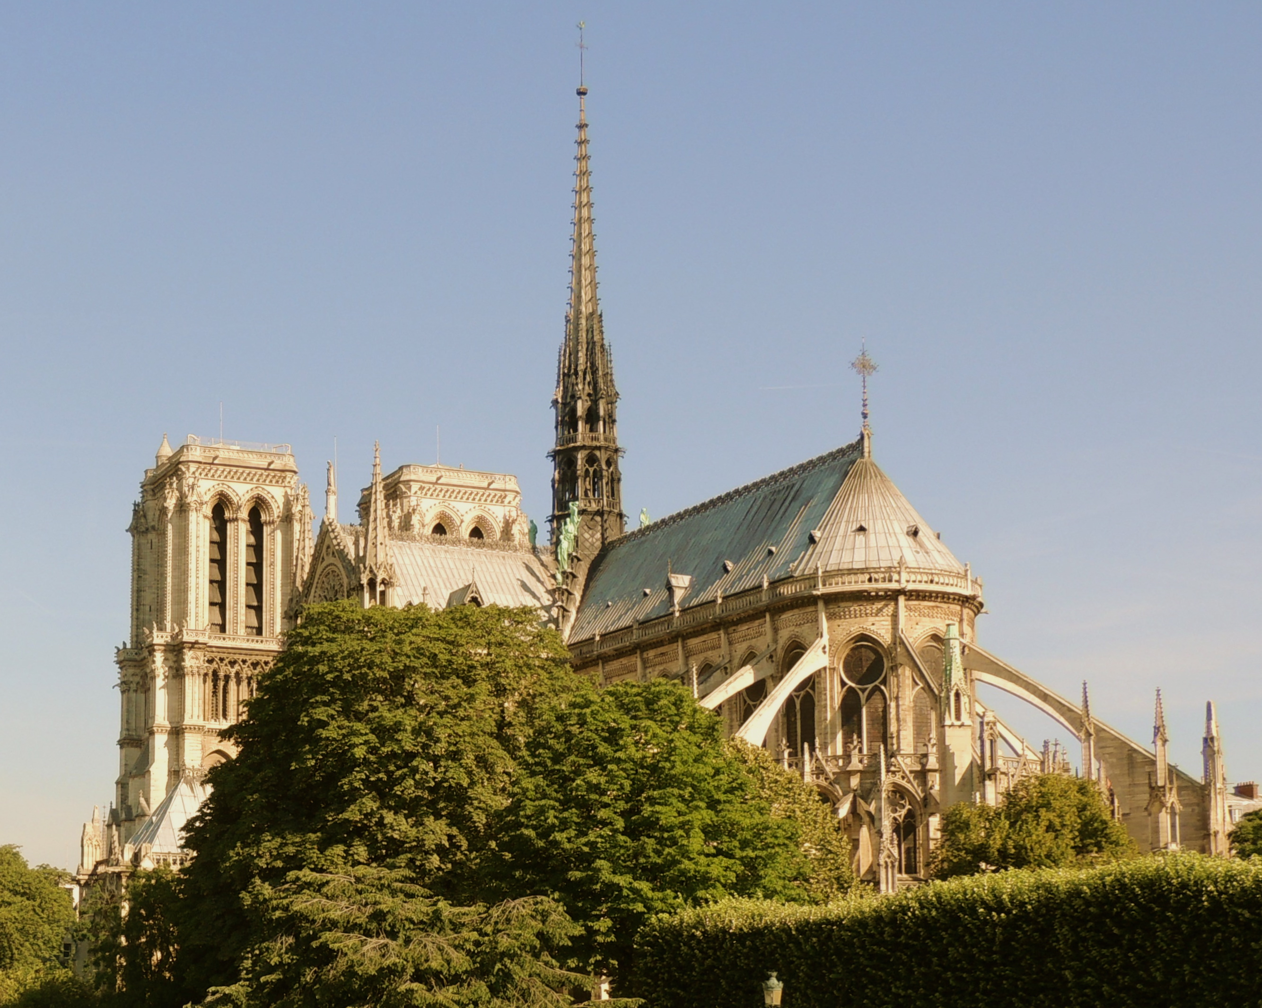
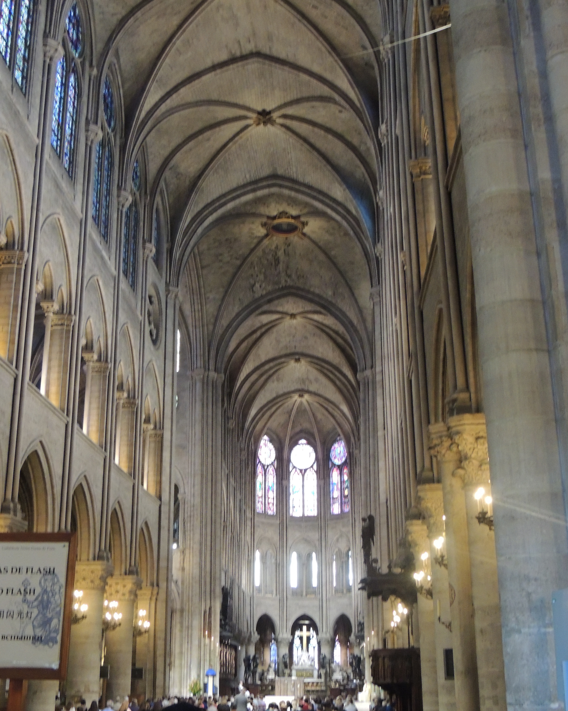
Cathedral of Notre Dame of Paris

Slide 3
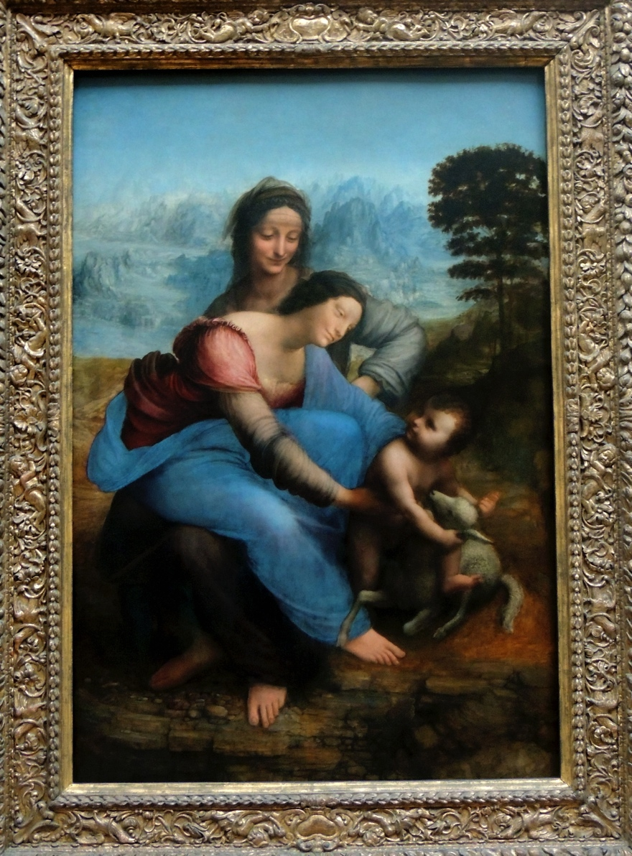
The Virgin and Child with
St. Anne
Leonardo Da Vinci (1508)

Slide 4
Christianity in Europe
"The history of Christianity is inseparable from the history of Western culture and of Western society. For almost a score of centuries Christian beliefs, principles, and ideals have colored the thoughts and feelings of Western man. The traditions and practices have left an indelible impress not only on developments of purely religious interest, but on virtually the total endeavor of man.

Slide 5
Christianity in Europe
This has been manifest in art and literature, science and law, politics and economics, and, as well, in love and war. Even those who have contested its claims and rejected its tenets have been affected by what they opposed. Whatever our beliefs, all of us today are inevitable heirs to this abundant legacy; and it is impossible to understand the cultural heritage that sustains and conditions our lives without considering the contributions of Christianity."

Slide 6
The Birth of Christianity in Europe
The Church began …

Slide 7
With God’s Spirit & Word
NOT
Human Logic
And they went through the region of Phrygia and Galatia, having been forbidden by the Holy Spirit to speak the word in Asia.
And when they had come up to Mysia, they attempted to go into Bithynia, but the Spirit of Jesus did not allow them.
So, passing by Mysia, they went down to Troas. And a vision appeared to Paul in the night: a man of Macedonia was standing there, urging him and saying, “Come over to Macedonia and help us.”

Slide 8
With Obedient Faith
NOT
Spirituality
And when Paul had seen the vision, immediately we sought to go on into Macedonia, concluding that God had called us to preach the gospel to them. So, setting sail from Troas, we made a direct voyage to Samothrace, and the following day to Neapolis, and from there to Philippi, which is a leading city of the district of Macedonia and a Roman colony. We remained in this city some days. (Acts 16:11-12, ESV)

Slide 9
In the Countryside
NOT in the City
And on the Sabbath day we went outside the gate to the riverside,

Slide 10
At a Prayer Meeting
NOT a Political Rally
where we supposed there was a place
of prayer, and

Slide 11
With Females
NOT
Males
we sat down and spoke to the women who had come together.

Slide 12
With An Immigrant
NOT a National
One who heard us was a woman named Lydia, from the city of Thyatira,

Slide 13
With a Small Business Owner
NOT
A King’s Treasury
a seller of purple goods,

Slide 14
With a God-Fearing Gentile
NOT a Religious Leader
who was a worshiper of God.

Slide 15
With Repentance
NOT
A Conversation
The Lord opened her heart to pay attention to what was said by Paul. And after she was baptized

Slide 16
With A Single Mother
NOT a Married Father
and her household as well,

Slide 17
With Hospitality
NOT
Isolation
she urged us, saying, “If you have judged me to be faithful to the Lord, come to my house and stay.” And she prevailed upon us.

Slide 18
The Church in Wildwood
But God chose what is foolish in the world to shame the wise;
God chose what is weak in the world to shame the strong;
God chose what is low and despised in the world, even things that are not, to bring to nothing things that are,
  so that no human being might boast in the presence of God.

Slide 19
The Church in Wildwood
And because of him you are in Christ Jesus,
who became to us wisdom from God, righteousness and sanctification and redemption,
so that, as it is written, “Let the one who boasts, boast in the Lord.”
(1 Corinthians 1:26-31 ESV)

