Slide 1
The Atonement
Implications for the Pastoral Task

Slide 2
1) Meditation and study
2) The personal application of the atonement to the pastor
3) The carrying out of the pastor’s ministry . . .

Slide 3
First, in preaching
This Photo by Unknown Author is licensed under CC BY-SA

Slide 4
ὁ παράκλητος—the Comforter.

Slide 5
John 14:16-18
¹⁶ κἀγὼ ἐρωτήσω τὸν πατέρα καὶ ἄλλον παράκλητον δώσει ὑμῖν ἵνα ^{[w]}ᾖ μεθ’ ὑμῶν εἰς τὸν ^{[x]}αἰῶνα,
¹⁷ τὸ πνεῦμα τῆς ἀληθείας, ὃ ὁ κόσμος οὐ δύναται λαβεῖν, ὅτι οὐ θεωρεῖ αὐτὸ οὐδὲ ^{[y]}γινώσκει· ^{[z]}ὑμεῖς γινώσκετε αὐτό, ὅτι παρ’ ὑμῖν μένει καὶ ἐν ὑμῖν ^{[aa]}ἔσται.
¹⁸ Οὐκ ἀφήσω ὑμᾶς ὀρφανούς, ἔρχομαι πρὸς ὑμᾶς.
¹⁶ And I will pray the Father, and he shall give you another Comforter, that he may abide with you for ever;
¹⁷ Even the Spirit of truth; whom the world cannot receive, because it seeth him not, neither knoweth him: but ye know him; for he dwelleth with you, and shall be in you.
¹⁸ I will not leave you comfortless: I will come to you.

Slide 6
John 14:16-18
¹⁶ κἀγὼ ἐρωτήσω τὸν πατέρα καὶ ἄλλον παράκλητον δώσει ὑμῖν ἵνα ^{[w]}ᾖ μεθ’ ὑμῶν εἰς τὸν ^{[x]}αἰῶνα,
¹⁷ τὸ πνεῦμα τῆς ἀληθείας, ὃ ὁ κόσμος οὐ δύναται λαβεῖν, ὅτι οὐ θεωρεῖ αὐτὸ οὐδὲ ^{[y]}γινώσκει· ^{[z]}ὑμεῖς γινώσκετε αὐτό, ὅτι παρ’ ὑμῖν μένει καὶ ἐν ὑμῖν ^{[aa]}ἔσται.
¹⁸ Οὐκ ἀφήσω ὑμᾶς ὀρφανούς, ἔρχομαι πρὸς ὑμᾶς.
¹⁶ And I will pray the Father, and he shall give you another Comforter, that he may abide with you for ever;
¹⁷ Even the Spirit of truth; whom the world cannot receive, because it seeth him not, neither knoweth him: but ye know him; for he dwelleth with you, and shall be in you.
¹⁸ I will not leave you comfortless: I will come to you.

Slide 7
(2 Cor 1:4).
“[God] comforteth us in all our tribulation, that we may be able to comfort them which are in any trouble, by the comfort wherewith we ourselves are comforted of God”

Slide 8
Second, in our conduct of the ceremonies
This Photo by Unknown Author is licensed under CC BY-SA

Slide 9
Reverence
This Photo by Unknown Author is licensed under CC BY-SA

Slide 10
Attention to Detail (Taking Pains)
This Photo by Unknown Author is licensed under CC BY-SA

Slide 11
Awareness of the Holy Presence
This Photo by Unknown Author is licensed under CC BY-SA

Slide 12
Faith
This Photo by Unknown Author is licensed under CC BY-SA

Slide 13
Humility
This Photo by Unknown Author is licensed under CC BY-SA

Slide 14
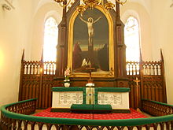
The Atonement on the Altar
This Photo by Unknown Author is licensed under CC BY-SA

Slide 15
Thirdly, in the Care of Souls

Slide 16
In times of joy
This Photo by Unknown Author is licensed under CC BY-SA

Slide 17
In times of sorrow
This Photo by Unknown Author is licensed under CC BY-SA
This Photo by Unknown Author is licensed under CC BY-SA

Slide 18
In times of celebration
This Photo by Unknown Author is licensed under CC BY-SA-NC

Slide 19
In times of trial
This Photo by Unknown Author is licensed under CC BY-SA
This Photo by Unknown Author is licensed under CC BY-NC-ND
This Photo by Unknown Author is licensed under CC BY-SA-NC

Slide 20
In times of sickness
This Photo by Unknown Author is licensed under CC BY-NC-ND
This Photo by Unknown Author is licensed under CC BY-SA-NC

Slide 21
And in the time of dying

Slide 22
Yet, to repeat a point, as His hands were not soiled at that first creation, so now He was not stained when He took sinful flesh from the Virgin Mary and brought forth from her the Lamb of God, immaculate and without the stain of sin. The humility of the Most-High God was not defiled when His hands formed His Son into the image of sinful man so that through that Man, made Sinner by a strange grace, He might redeem and sanctify those who are in truth sinners.

Slide 23
By his stripes, we are healed, proclaims the prophet. In his abasement, we are exalted.
- William Weinrich, Easter week sermon, CTS, Fort Wayne, Indiana 2018

Slide 24
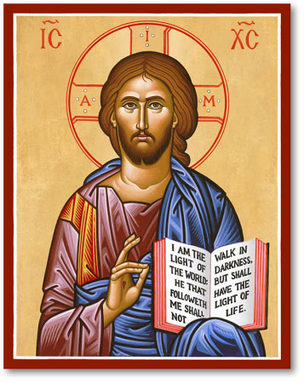

Slide 25
For in times long past, it was said that man was created after the image of God, but it was not [actually] shown; for the Word was as yet invisible, after whose image man was created. Wherefore also did he easily lose the similitude. When, however, the Word became flesh, He confirmed both these: for He both showed forth the image truly, since He became himself what was His image; and He re-established

Slide 26
the similitude after a sure manner, by assimilating man to the invisible Father through means of the visible Word.”
Against Heresies, Book V: 16, 2, Ante-Nicene Fathers Vol. 1. Alexander Roberts and James Donaldson, eds. [Grand Rapids, Mich.: Eerdmans, 1989], 544.

Slide 27
He purposely adopted the plural phrase, ‘Let us make;” and, “in our image;” and, “become as one of us.” For with whom did He make man? and to whom did He make him like? (The answer must be), the Son on the one hand, who was one day to put on human nature; and the Spirit on the other, who was to sanctify man. . .

Slide 28
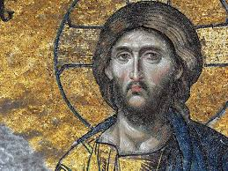

Slide 29
But there was One in whose image God was making man, that is to say, Christ’s image, who, being one day about to become Man (more surely and more truly so), had already caused the man to be called His image, who was then going to be formed of clay—the image and similitude of the true and perfect Man” Tertullian, Against Praxeas, Ch. 12, Ante-Nicene Fathers Vol. 3. Alexander Roberts and James Donaldson, eds. [Grand Rapids, Mich.: Eerdmans, 1989], 606f).

Slide 30
To whom does He say, “in our image,” to whom if it is not to Him who is “the brightness of His glory and the express image of His person,” “the image of the invisible God”? It is then to His living image, to Him who has said, “I and my Father are one,” “He that hath seen me hath seen the Father,” that God says “Let us make man in our image.” . . . “Man was created in the image of God, and . . . shares this resemblance” (Basil of Caesarea, Hom. IX, 6; NPNF, 2nd ser., Vol 8 [Grand Rapids: Eerdmans, 1989], 106f).

Slide 31
“in the Old the New lies concealed,
in the New the Old is revealed.”
- late medieval rhyme

Slide 32
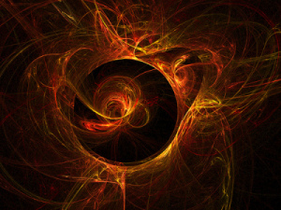

Slide 33
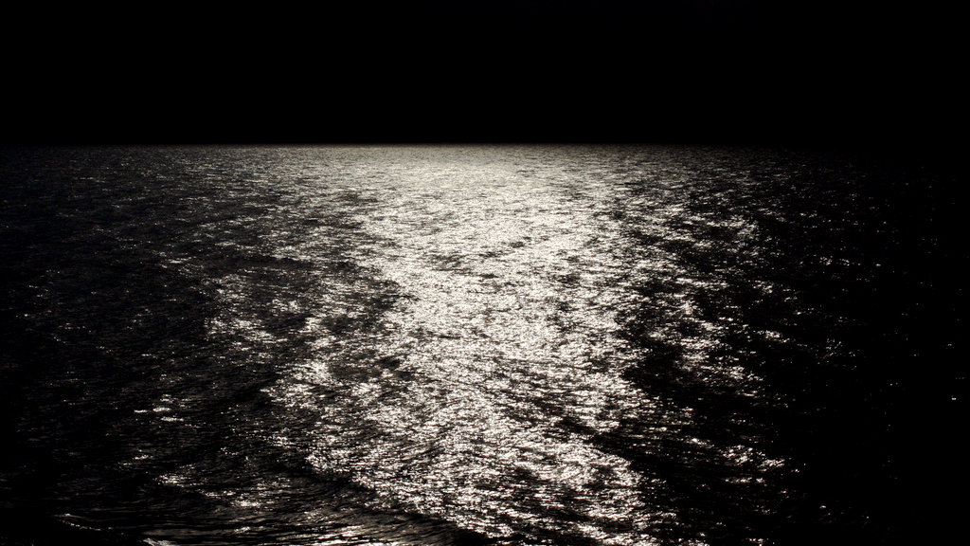
This Photo by Unknown Author is licensed under CC BY

Slide 34
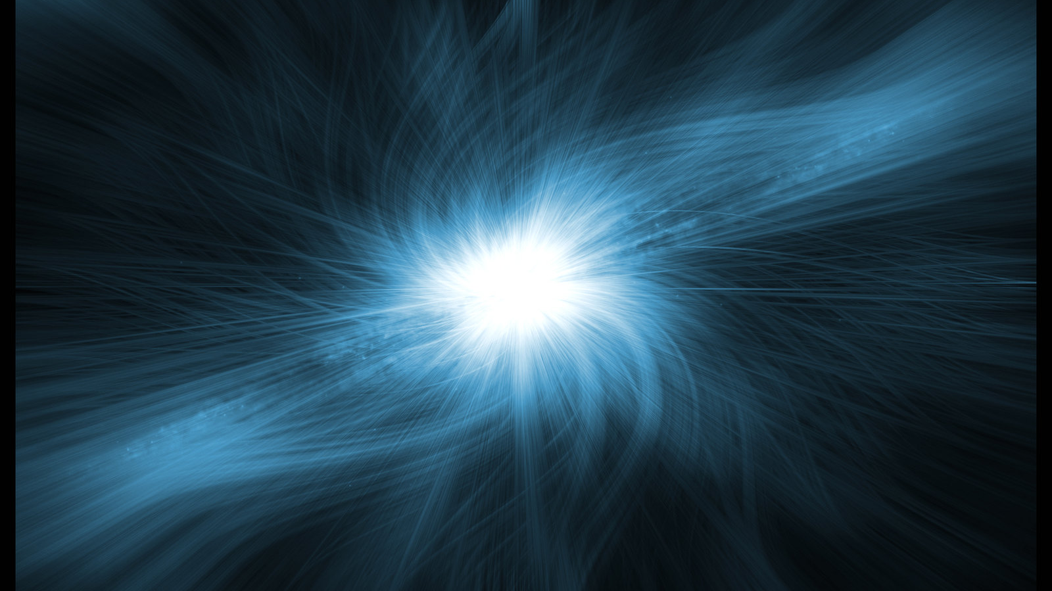
This Photo by Unknown Author is licensed under CC BY-SA

Slide 35
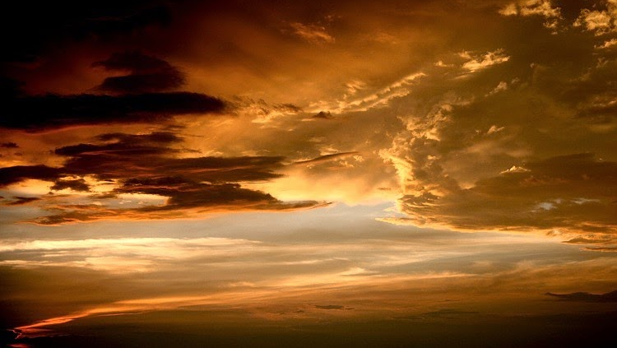
This Photo by Unknown Author is licensed under CC BY-NC-ND

Slide 37
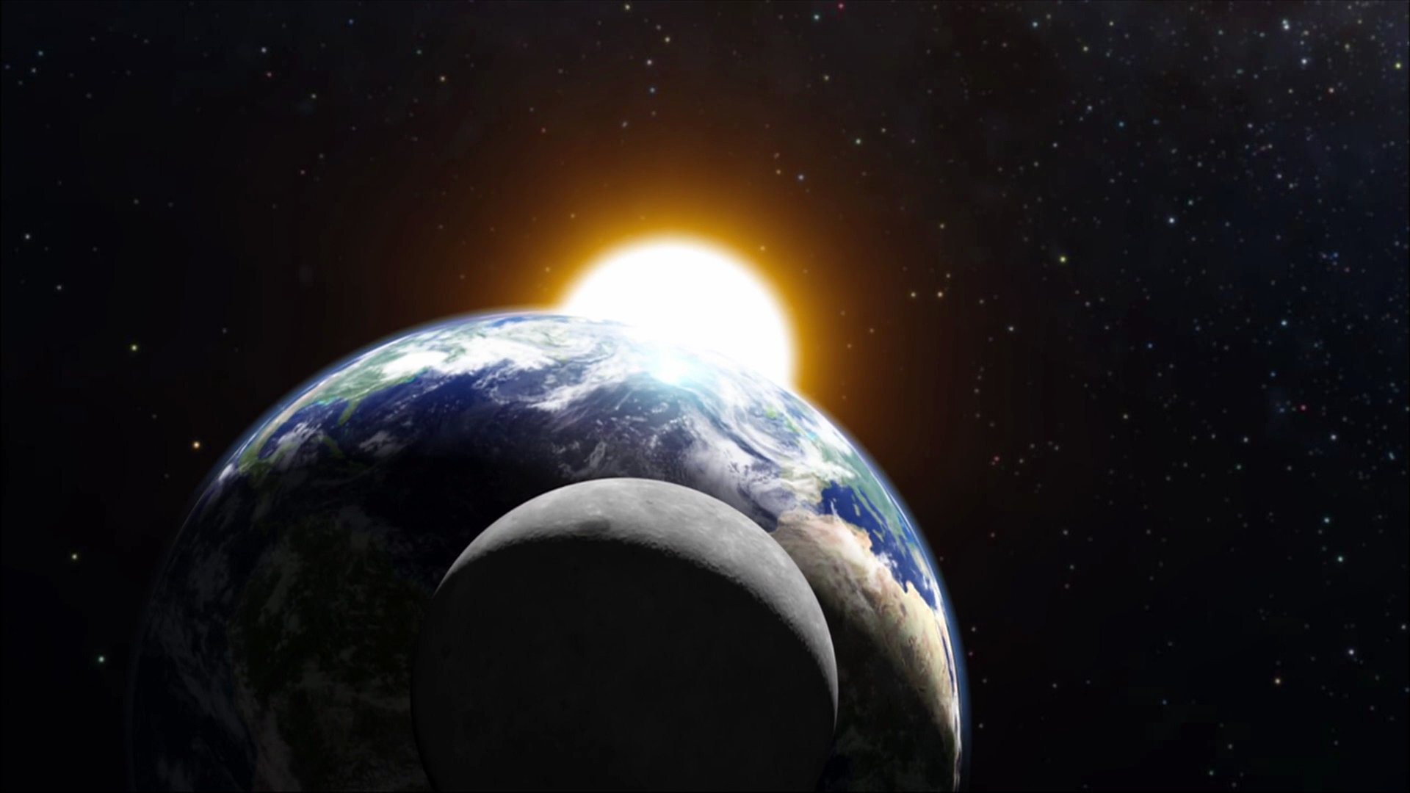
This Photo by Unknown Author is licensed under CC BY-SA

Slide 38
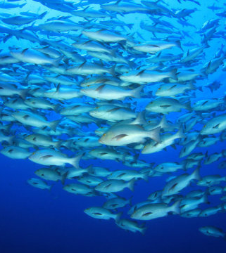
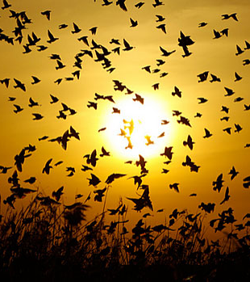

Slide 39
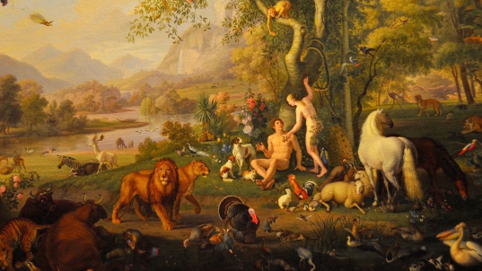

Slide 40
Therefore the image of God in which Adam was created was . . . of the purest kind.

Slide 41
His intellect was the purest, his memory was the best, and his will was the most straightforward —all in the most beautiful tranquility of mind, without any fear of death and without any anxiety.

Slide 42
To these inner qualities came also the most beautiful and superb qualities of body and of all the limbs,

Slide 43
qualities in which he surpassed all the remaining creatures
This Photo by Unknown Author is licensed under CC BY-NC-SA

Slide 44
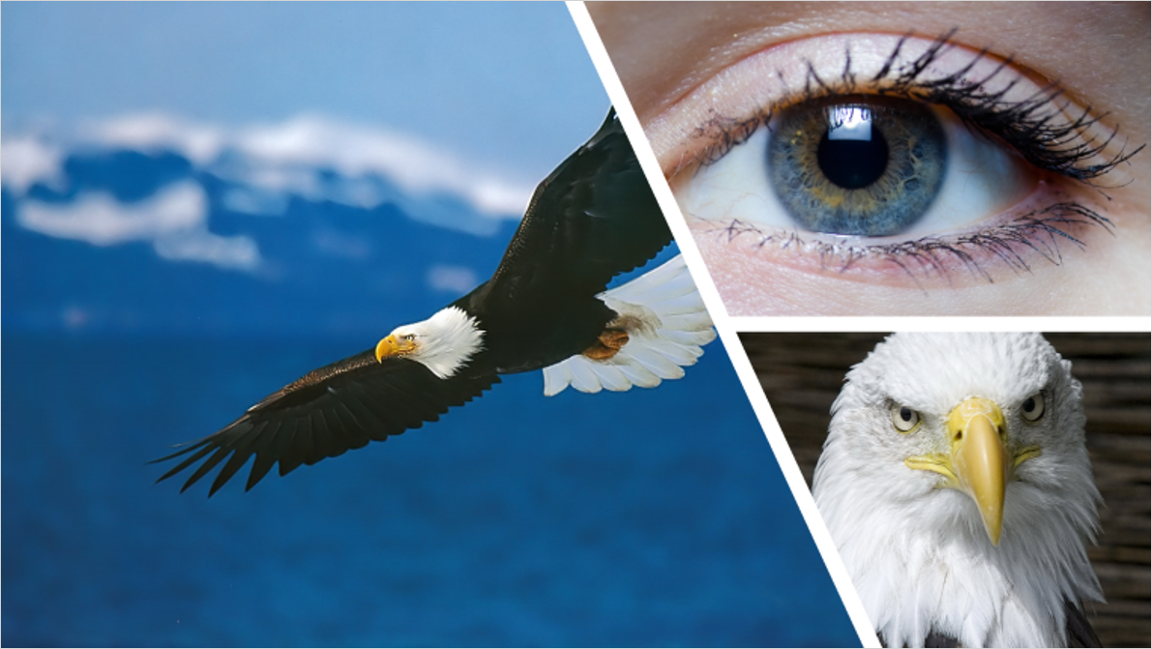
I am fully convinced that before Adam’s sin, his eyes were so sharp and clear that they surpassed those of the lynx and eagle.

Slide 45
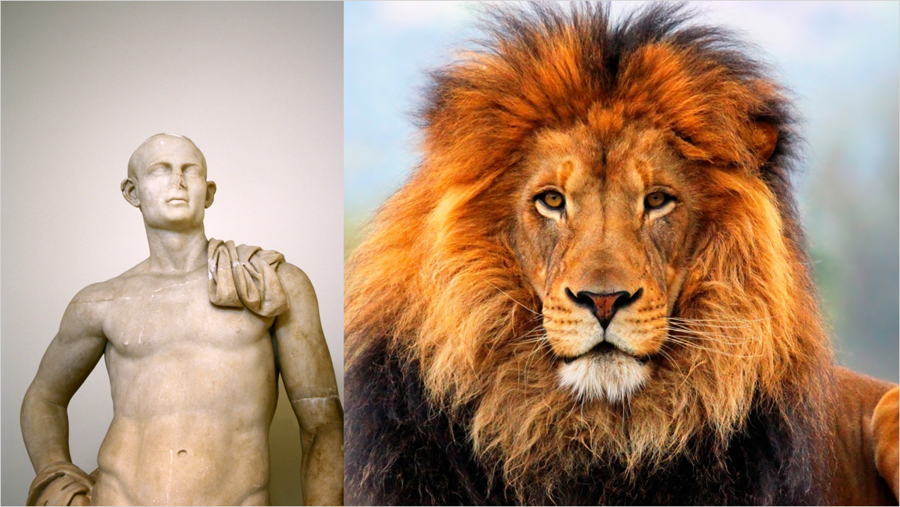
He was stronger than the lions and bears; whose strength is very great, and he handled them the way we handle puppies.
Martin Luther, AE Vol. 1: Lectures on Genesis, Chapters 1-5. Transl., George Schick [St. Louis: Concordia, 1958] s.v. Genesis 1:26

Slide 46
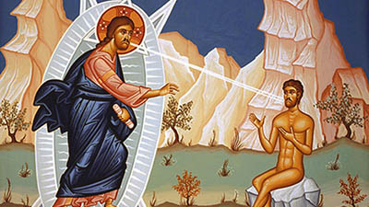

Slide 47
Philip saith unto him, Lord, show us the Father, and it sufficeth us. Jesus saith unto him, Have I been so long time with you, and yet hast thou not known me, Philip? he that hath seen me hath seen the Father; and how sayest thou then, Show us the Father?

Slide 48
How, then, did God make man and endow him with the divine image? Here we enter into the workshop of the divine Potter. God, bending low, stretched out his two hands and took dust from the earth. Dust from the dust. Adam from Adam. And, as it were, holding the dust in his two hands, God breathed out His Breath. He blew His Spirit, not so much at the dust or on the dust, but into the dust. In and through that breathing the dust became man, a living being.

Slide 49
Think of that, O man! From the beginning, at the beginning God lifted up man high, exalting him above all creatures. What an exaltation that was! From dust man became the temple of God’s own Breath! By the humble bending low of the divine majesty, out of love and mercy, dust had become the partaker of God’s own Spirit. Dust, now called by the personal name of Adam, was the image of God’s own eternity, destined to life with God as his own birthright, endowed with

Slide 50
those virtues by which God Himself lives and exists—charity, humility, long-suffering, patience, faithfulness, truthfulness, goodness.

Slide 51
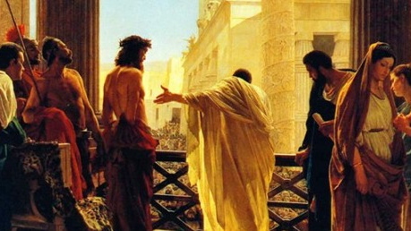

Slide 52
What had been given from God had by a terrible choice been assigned to the realms of hades. Man exalted himself, thinking the things of God to be for the taking, and going up, had cast himself down into disaster and captivity, dragged off as a prisoner under the shadow of death. In the dust lay desolate the Father’s image!

Slide 53
That was at the beginning which as yet was not the end. That beginning is, nonetheless, our own present. We are all at that beginning sharing with Adam the dust of his own sin. But there is another Beginning which according to its own strangeness is also the End. And this End is a new beginning.

Slide 54
Let us remember, O sinners, what the Evangelist says, “God is love, and for us and for our salvation loved us by giving over His Son through the exaltation of the Son of man on the cross. What a marvel that is! The cross as exaltation, and the exaltation of the Son of man as the humble obedience of the cross. How are we to understand this? How are we to will this as our own way? How are we to live this as the truth of our own new being? - Weinrich

Slide 56
So God created man in his own image, in the image of God created he him; male and female created he them.

Slide 57
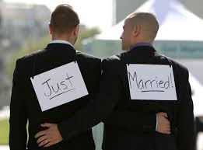

Slide 58
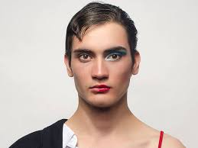

Slide 59
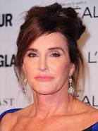

Slide 60
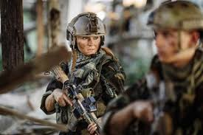

Slide 61
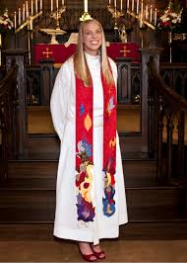

Slide 62
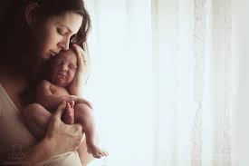

Slide 63
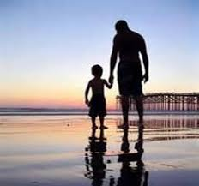

Slide 65
