Slide 1
Ecce Homo
The Image of God, the Incarnation, and the Pastoral Office

Slide 2
Thesis: the image of God is more than simply ‘righteousness’; it is imperative to understand the image of God in a wider sense as well, having additional facets that, while consistent with this interpretation, expand upon it, if we are to be faithful to the Biblical record and gain a fuller appreciation of its relation to the Incarnation of God and to the Office of the Holy Ministry.

Slide 3
Luther’s Small Catechism (Explanation)
1986 Edition
2017 Edition
What was the image of God?
The image of God was this: A. Adam and Eve truly knew God as He wishes to be known and were perfectly happy in Him. . . . B. They were righteous and holy, doing God’s will. .
Do people still have the image of God?
No, this image was lost when our first parents disobeyed God and fell into sin. Their will and intellect lost the ability to know and please God. In Christians God has begun to rebuild His image, but only in heaven will it be fully restored.
(q 106-107, p 115).
Do we still have the image of God?
A. Since the fall into sin, we lost the ability to live by faith in God, in perfect love toward one another, and in a proper relationsip to creation (original righteousness). In this sense, we have lost the image of God.
B. However, we still possess unique dignity (or worth) as those who were created in the image of God and were given dominion in creation.
(q 214, p 140)

Slide 4
Genesis 1:26: “Let us make man in our image . . . Let them have dominion”
Let us make
Let them have dominion
Image
the plurality of Persons in the godhead
Dominion
appearance

Slide 5
בצלם אלֹהם

Slide 6
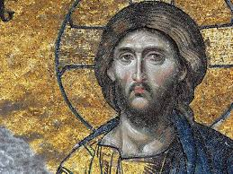

Slide 7
It was no insult to the Heavenly Architect to dwell in the temple which He had built. Nor did the dust of the earth soil the hands of the Potter when he made man. And so, it was not alien to our Heavenly Father when once again, as at that first beginning, He bent himself low and revealed Himself anew to be Humility when He formed man anew from the wondrous dust of the Virgin’s womb. There was, of course, this difference—now the Humility which is God had to bend himself even lower than at the first beginning, for man had so far sunk down that the divine Charity had, so to speak, to reveal itself even more.

Slide 8
Yet, to repeat a point, as His hands were not soiled at that first creation, so now He was not stained when He took sinful flesh from the Virgin Mary and brought forth from her the Lamb of God, immaculate and without the stain of sin. The humility of the Most-High God was not defiled when His hands formed His Son into the image of sinful man so that through that Man, made Sinner by a strange grace, He might redeem and sanctify those who are in truth sinners.

Slide 9
By his stripes, we are healed, proclaims the prophet. In his abasement, we are exalted.
- William Weinrich, Easter week sermon, CTS, Fort Wayne, Indiana 2018

Slide 10
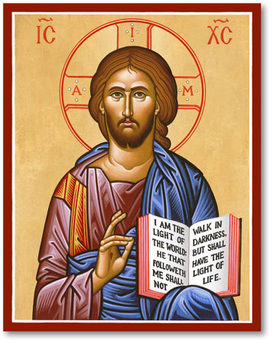

Slide 11
For in times long past, it was said that man was created after the image of God, but it was not [actually] shown; for the Word was as yet invisible, after whose image man was created. Wherefore also did he easily lose the similitude. When, however, the Word became flesh, He confirmed both these: for He both showed forth the image truly, since He became himself what was His image; and He re-established

Slide 12
the similitude after a sure manner, by assimilating man to the invisible Father through means of the visible Word.”
Against Heresies, Book V: 16, 2, Ante-Nicene Fathers Vol. 1. Alexander Roberts and James Donaldson, eds. [Grand Rapids, Mich.: Eerdmans, 1989], 544.

Slide 13
He purposely adopted the plural phrase, ‘Let us make;” and, “in our image;” and, “become as one of us.” For with whom did He make man? and to whom did He make him like? (The answer must be), the Son on the one hand, who was one day to put on human nature; and the Spirit on the other, who was to sanctify man. . .

Slide 14
But there was One in whose image God was making man, that is to say, Christ’s image, who, being one day about to become Man (more surely and more truly so), had already caused the man to be called His image, who was then going to be formed of clay—the image and similitude of the true and perfect Man” Tertullian, Against Praxeas, Ch. 12, Ante-Nicene Fathers Vol. 3. Alexander Roberts and James Donaldson, eds. [Grand Rapids, Mich.: Eerdmans, 1989], 606f).

Slide 15
To whom does He say, “in our image,” to whom if it is not to Him who is “the brightness of His glory and the express image of His person,” “the image of the invisible God”? It is then to His living image, to Him who has said, “I and my Father are one,” “He that hath seen me hath seen the Father,” that God says “Let us make man in our image.” . . . “Man was created in the image of God, and . . . shares this resemblance” (Basil of Caesarea, Hom. IX, 6; NPNF, 2nd ser., Vol 8 [Grand Rapids: Eerdmans, 1989], 106f).

Slide 16
“in the Old the New lies concealed,
in the New the Old is revealed.”
- late medieval rhyme

Slide 17
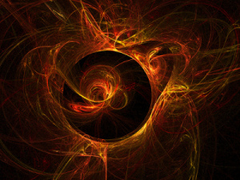

Slide 18
This Photo by Unknown Author is licensed under CC BY

Slide 19
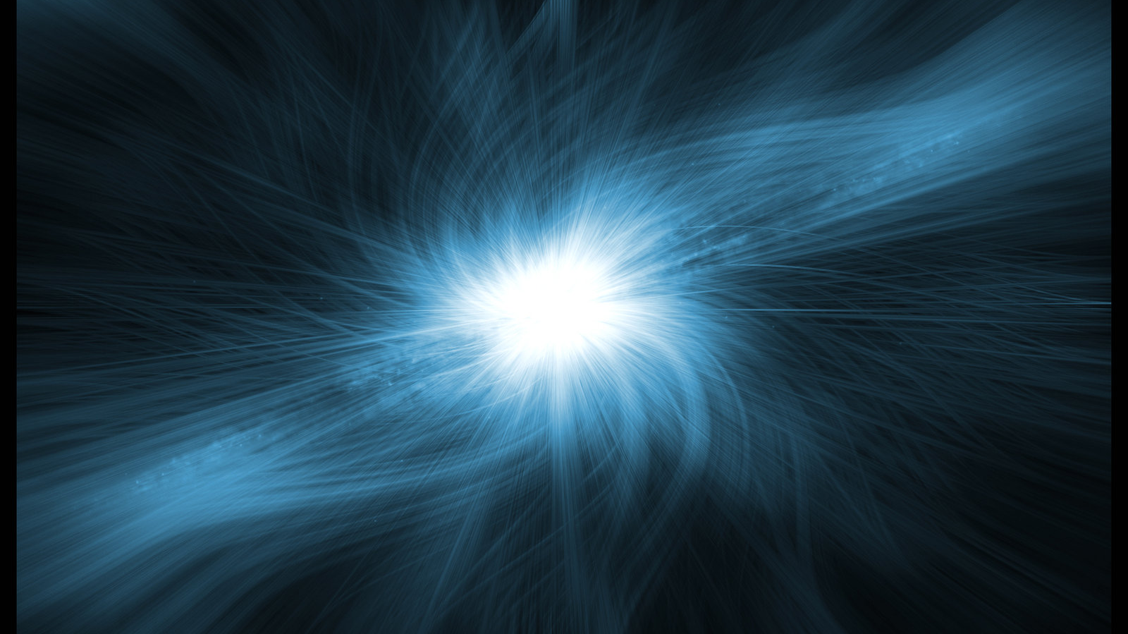
This Photo by Unknown Author is licensed under CC BY-SA

Slide 20
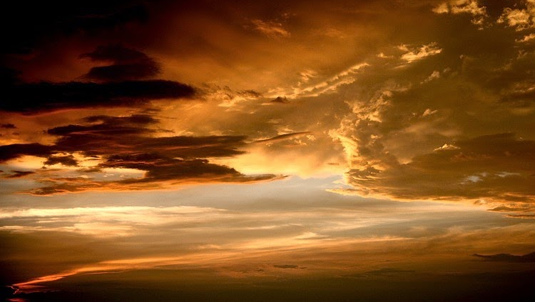
This Photo by Unknown Author is licensed under CC BY-NC-ND

Slide 22
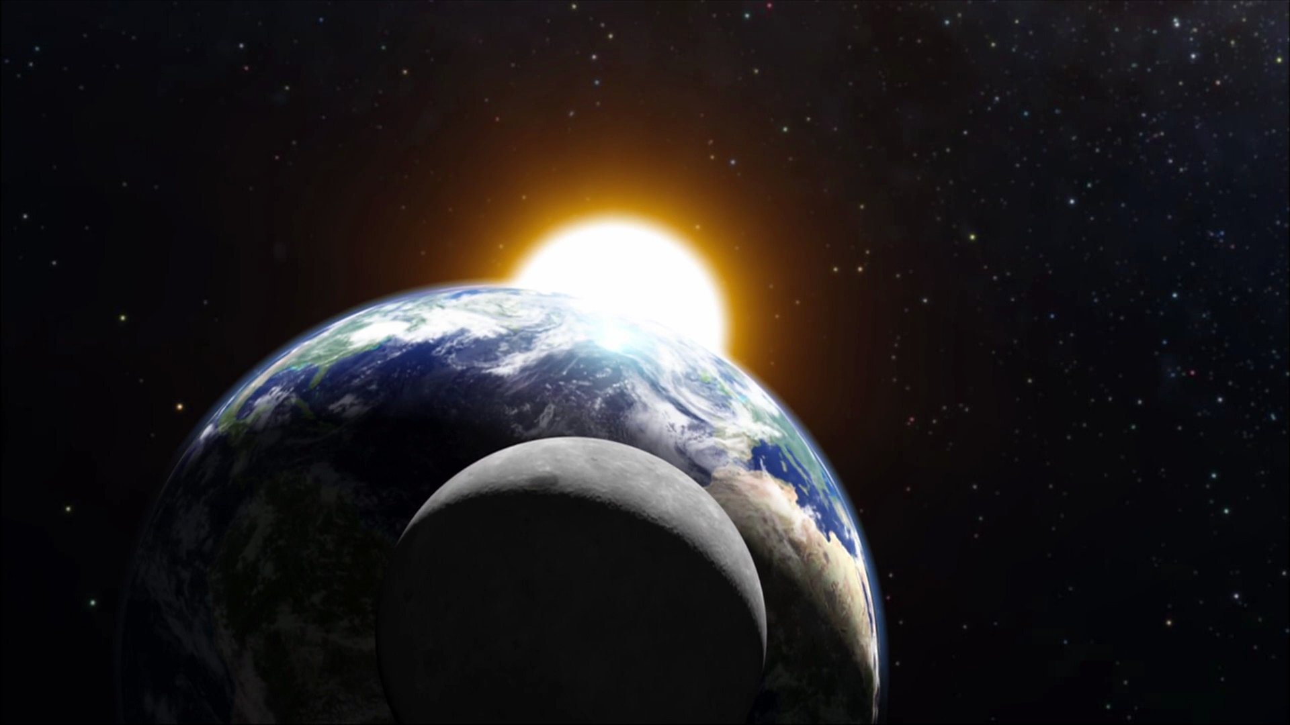
This Photo by Unknown Author is licensed under CC BY-SA

Slide 23
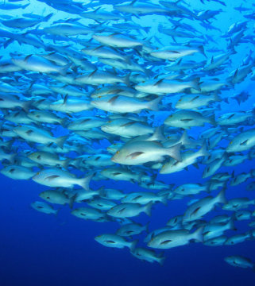
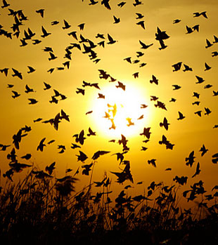

Slide 24
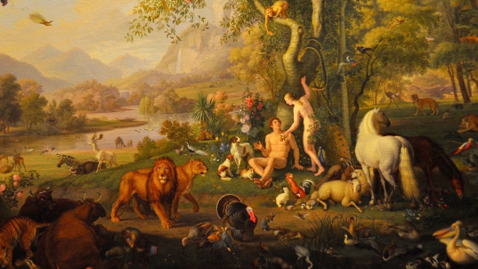

Slide 25
Therefore the image of God in which Adam was created was . . . of the purest kind.

Slide 26
His intellect was the purest, his memory was the best, and his will was the most straightforward —all in the most beautiful tranquility of mind, without any fear of death and without any anxiety.

Slide 27
To these inner qualities came also the most beautiful and superb qualities of body and of all the limbs,

Slide 28
qualities in which he surpassed all the remaining creatures
This Photo by Unknown Author is licensed under CC BY-NC-SA

Slide 29
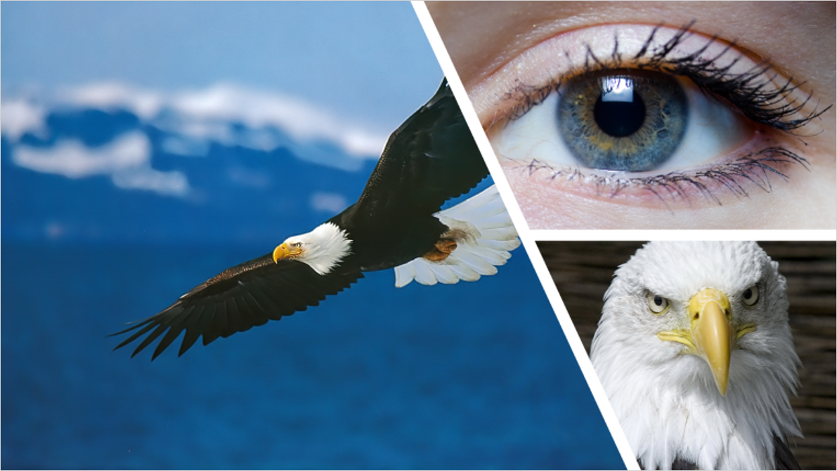
I am fully convinced that before Adam’s sin, his eyes were so sharp and clear that they surpassed those of the lynx and eagle.

Slide 30
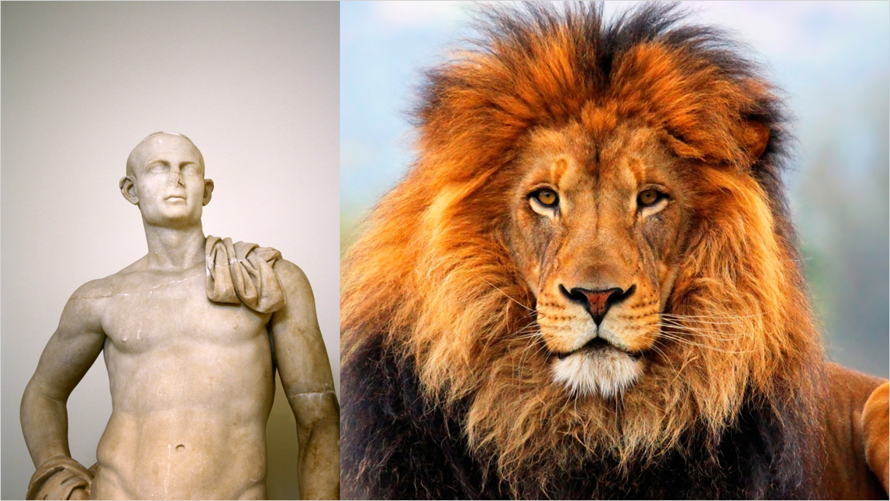
He was stronger than the lions and bears; whose strength is very great, and he handled them the way we handle puppies.
Martin Luther, AE Vol. 1: Lectures on Genesis, Chapters 1-5. Transl., George Schick [St. Louis: Concordia, 1958] s.v. Genesis 1:26

Slide 31
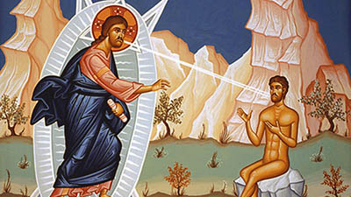

Slide 32
Philip saith unto him, Lord, show us the Father, and it sufficeth us. Jesus saith unto him, Have I been so long time with you, and yet hast thou not known me, Philip? he that hath seen me hath seen the Father; and how sayest thou then, Show us the Father?

Slide 33
How, then, did God make man and endow him with the divine image? Here we enter into the workshop of the divine Potter. God, bending low, stretched out his two hands and took dust from the earth. Dust from the dust. Adam from Adam. And, as it were, holding the dust in his two hands, God breathed out His Breath. He blew His Spirit, not so much at the dust or on the dust, but into the dust. In and through that breathing the dust became man, a living being.

Slide 34
Think of that, O man! From the beginning, at the beginning God lifted up man high, exalting him above all creatures. What an exaltation that was! From dust man became the temple of God’s own Breath! By the humble bending low of the divine majesty, out of love and mercy, dust had become the partaker of God’s own Spirit. Dust, now called by the personal name of Adam, was the image of God’s own eternity, destined to life with God as his own birthright, endowed with

Slide 35
those virtues by which God Himself lives and exists—charity, humility, long-suffering, patience, faithfulness, truthfulness, goodness.

Slide 36
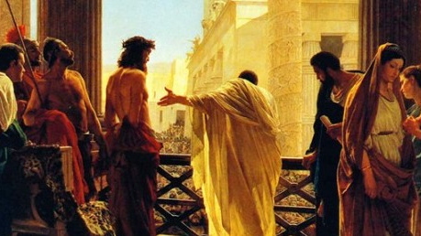

Slide 37
What had been given from God had by a terrible choice been assigned to the realms of hades. Man exalted himself, thinking the things of God to be for the taking, and going up, had cast himself down into disaster and captivity, dragged off as a prisoner under the shadow of death. In the dust lay desolate the Father’s image!

Slide 38
That was at the beginning which as yet was not the end. That beginning is, nonetheless, our own present. We are all at that beginning sharing with Adam the dust of his own sin. But there is another Beginning which according to its own strangeness is also the End. And this End is a new beginning.

Slide 39
Let us remember, O sinners, what the Evangelist says, “God is love, and for us and for our salvation loved us by giving over His Son through the exaltation of the Son of man on the cross. What a marvel that is! The cross as exaltation, and the exaltation of the Son of man as the humble obedience of the cross. How are we to understand this? How are we to will this as our own way? How are we to live this as the truth of our own new being? - Weinrich

Slide 41
So God created man in his own image, in the image of God created he him; male and female created he them.

Slide 42
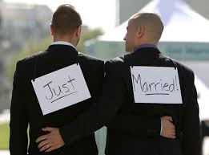

Slide 43
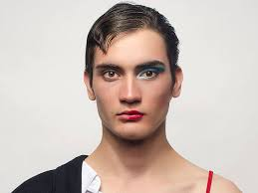

Slide 44
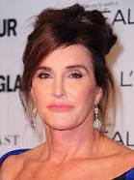

Slide 45
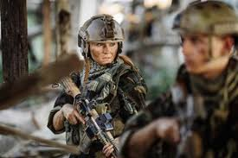

Slide 46
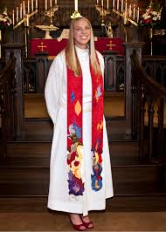

Slide 47
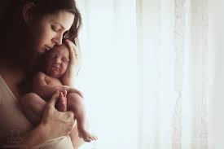

Slide 48
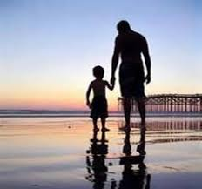

Slide 50
